Slide 1
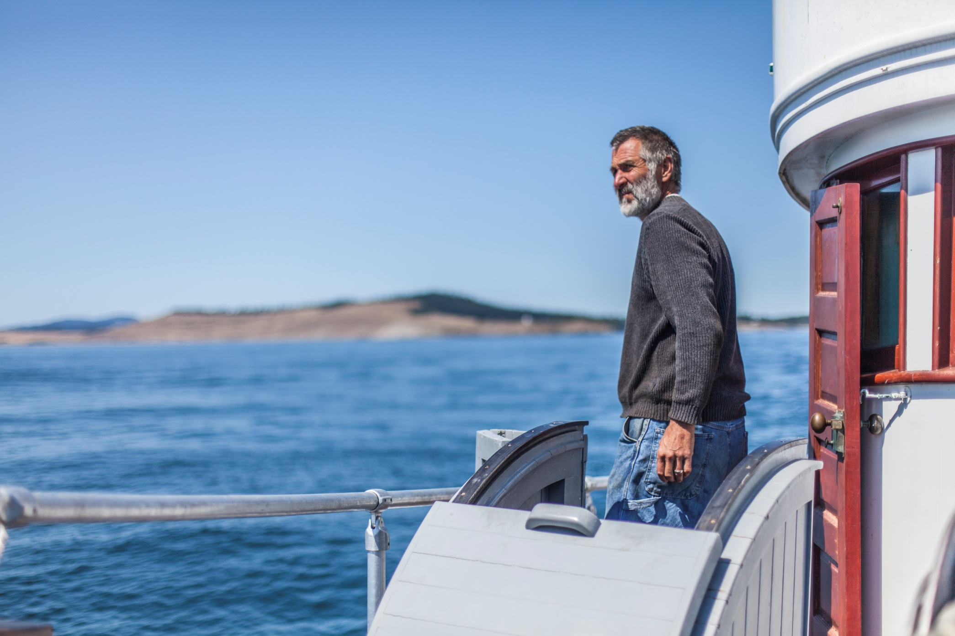
a maritime heritage story
Notes:
I want to share with you how and why I strive to live my heritage – my story. How and when it began. The transformations and challenges. Where I am currently at, and my visions for the future.

Slide 2
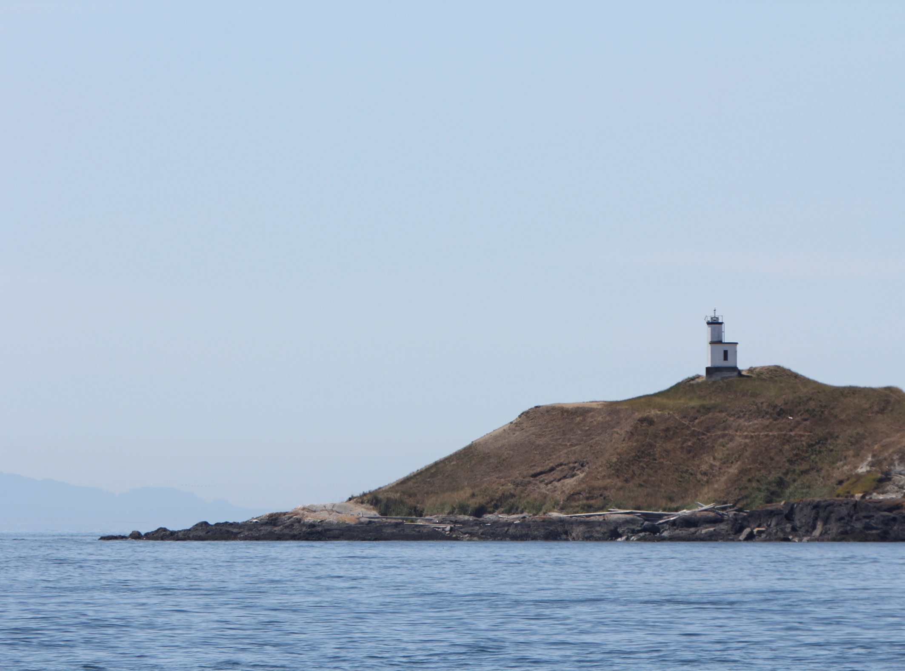
Stories from the Galley
Maritime Heritage in the
Service of Education and
Social Entrepreneurship: Cultural Lecture and Dialogue.
Notes:
The importance of stories, how they were told on the fishing boats, how I learned about my heritage—my family history, my Croatian roots.

Slide 3
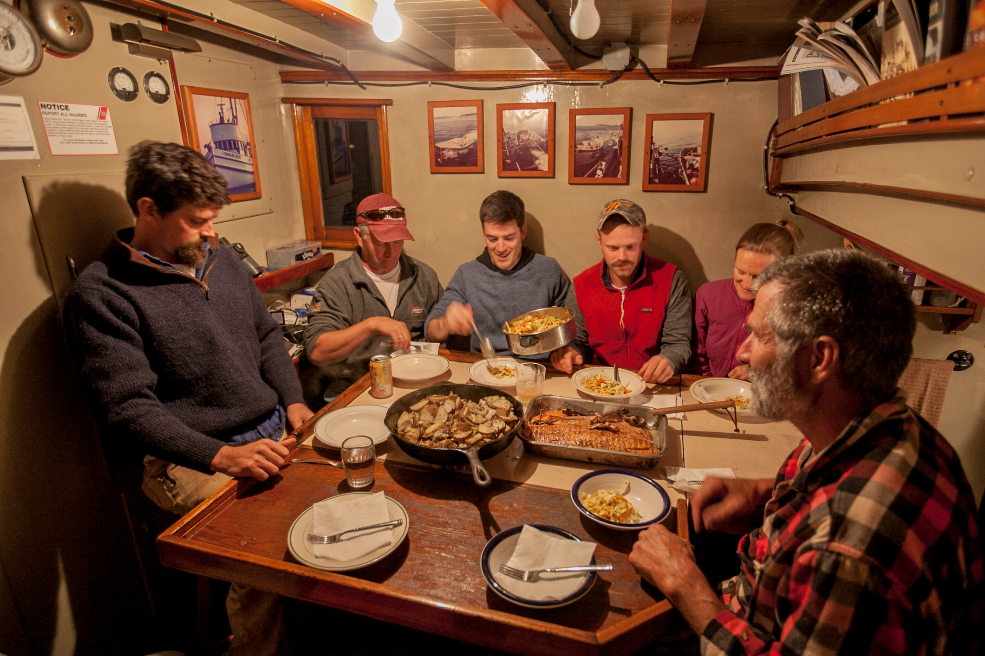
new faces – old stories
Teachers & students during a summer field experience, living and learning together.

Slide 4
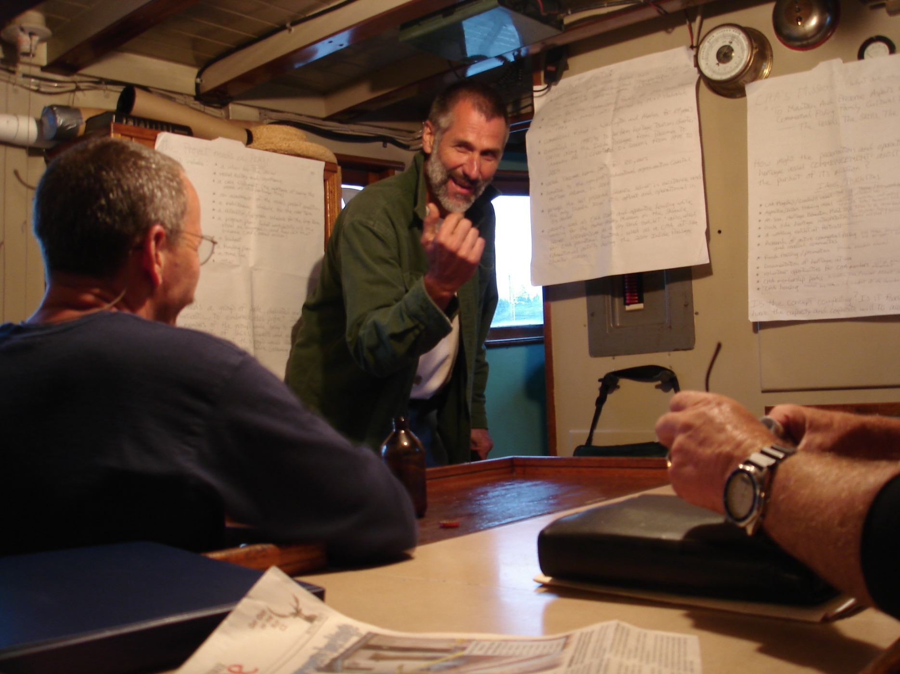
to hell with the facts, give me stories!
Storytelling:
Revealing the cultural truth hidden behind the recorded historical facts.
It`s a way to teach others, and a way to better understand ourselves.
Notes:
I`m not a historian, more of a cultural researcher believing in the power of traditional stories (oral histories)---because they provide a “window” into cultures values, practices, beliefs. Stories demonstrate and reinforce what matters most to human beings at their deepest level.

Slide 5
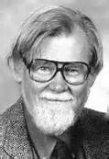
the dilemma
How do we then …. "remain true to the spirit of tradition in circumstances that have changed apart from their functional relevance within structure”?
Dell Hymes, Folklorist & Scholar
There exists “continuous tension between tradition and situation, tradition defining situations, situations displacing traditions, both inevitable and mutually changing.”
Notes:
But how do I do that “apart from their functional relevance within structure”? Are we currently in a period of time when changes to situations are accelerating? So, how do we make valued traditions relevant in the midst of rapid change? Are existing institutions meeting the challenge? Are they sufficiently flexible and adaptable to address rapid change? Are we as human beings adaptable?

Slide 6
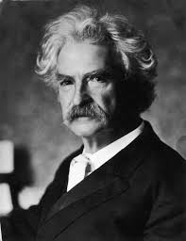
the Aha moment
“The two most important days in a person`s life are the day they are born, and the day they find out why”.
Mark Twain
Notes:
Searching for meaning, for purpose. What`s my place in the world? Why was I born? When will I ever find out why?

Slide 7
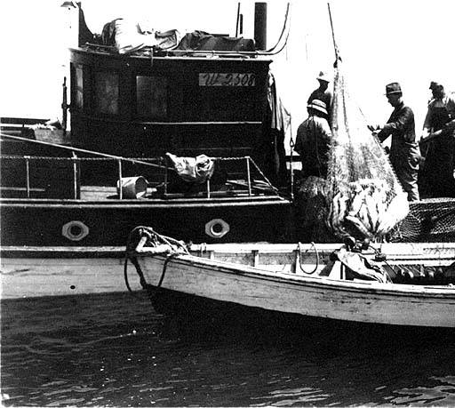
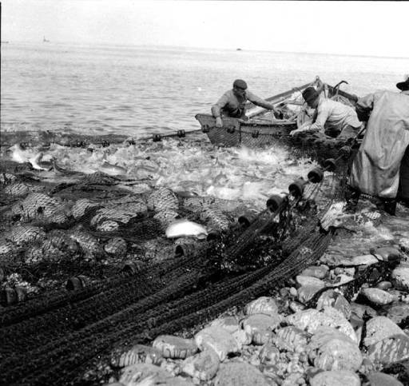
fish in abundance, couldn`t catch them all!
the salmon
Notes:
They were able to use their traditional Croatian maritime skills to harvest the wild salmon which appeared to be endless in supply.

Slide 8
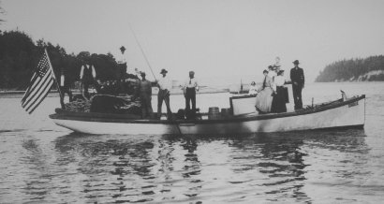
a stable traditional family structure
based upon seafood harvesting.
Notes:
The Croatian American fishing community grew in numbers.

Slide 9
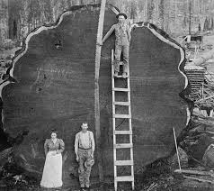
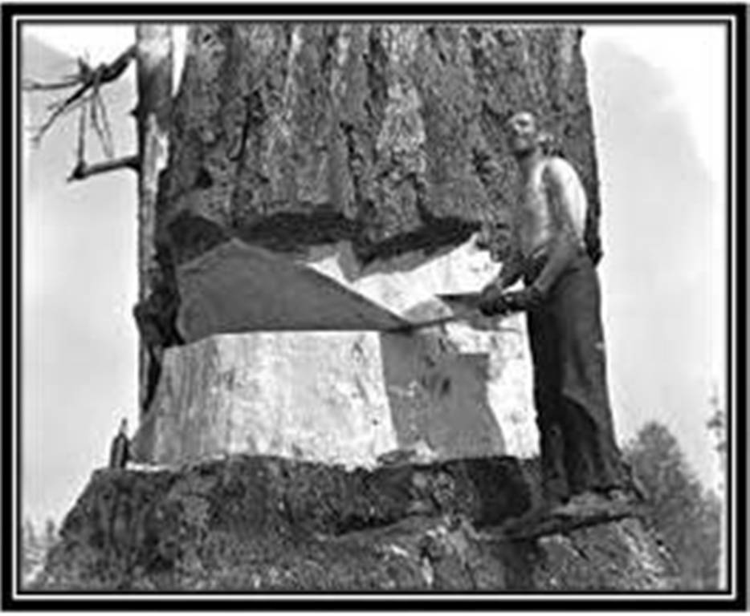
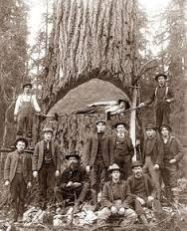
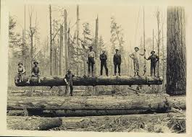
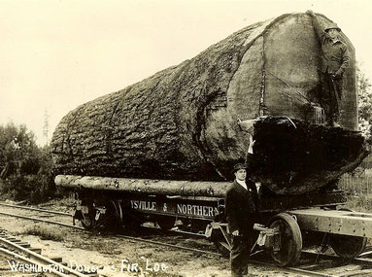
big trees = wooden boats
Notes:
Ancient forests thousands of years old.

Slide 10
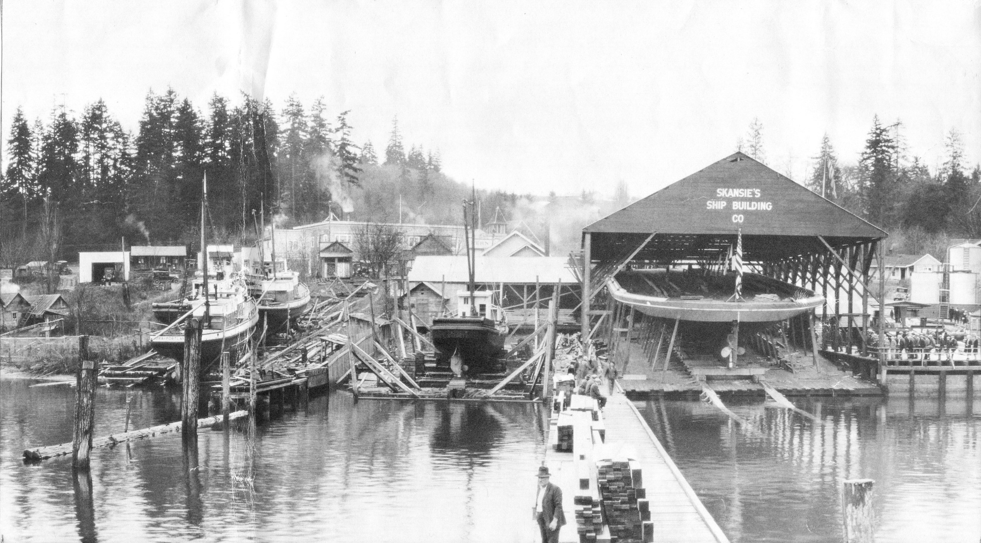
wooden boats = shipyards
Notes:
Skansie Shipbuilding & Transportation Company, built and operated by Croatian immigrants. The naval architect was Mr. Kasalin from the Island of Brac.

Slide 11
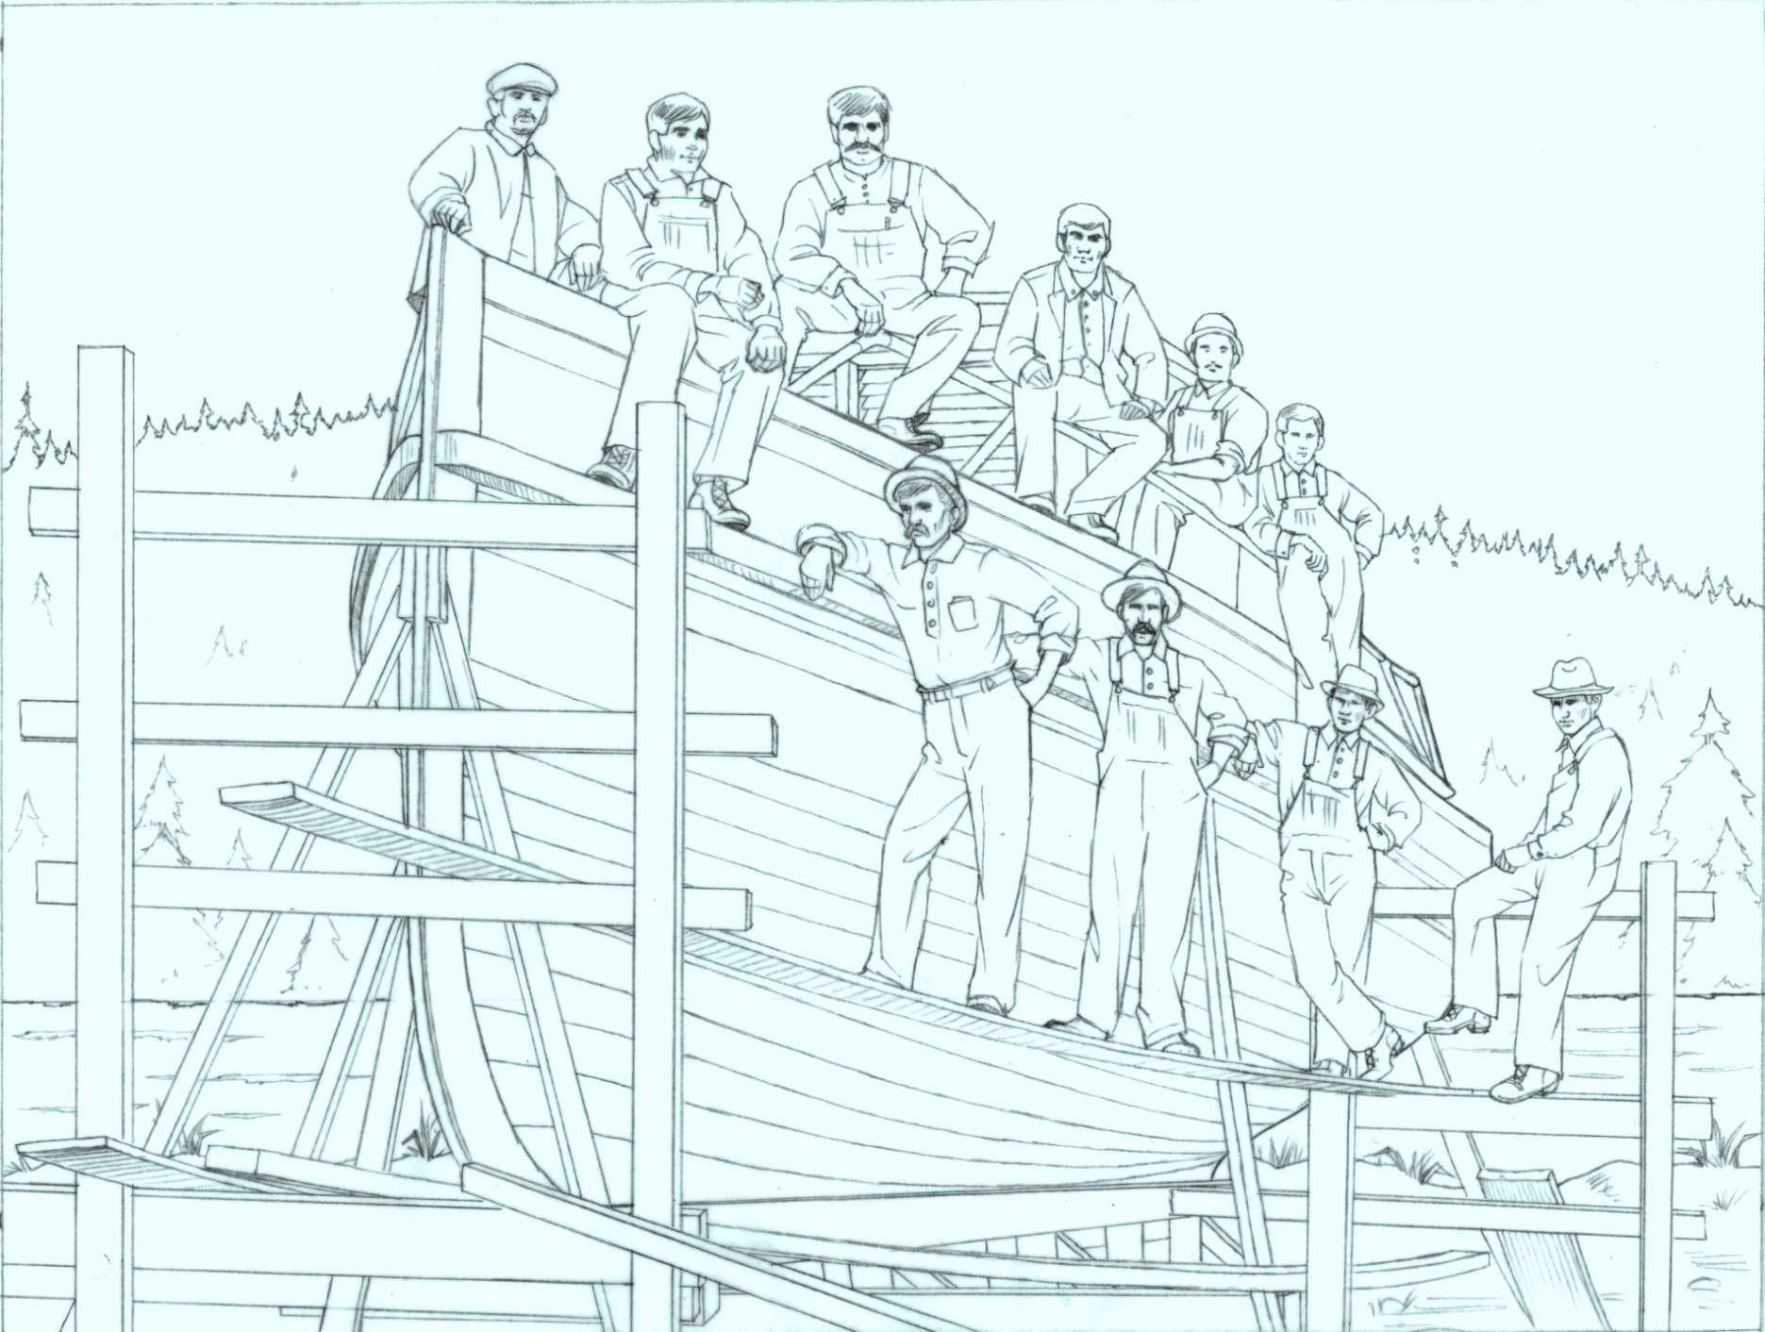
shipyards = maritime skills
Notes:
Croatian American craftsmen – masters in the art of wooden shipbuilding.

Slide 12
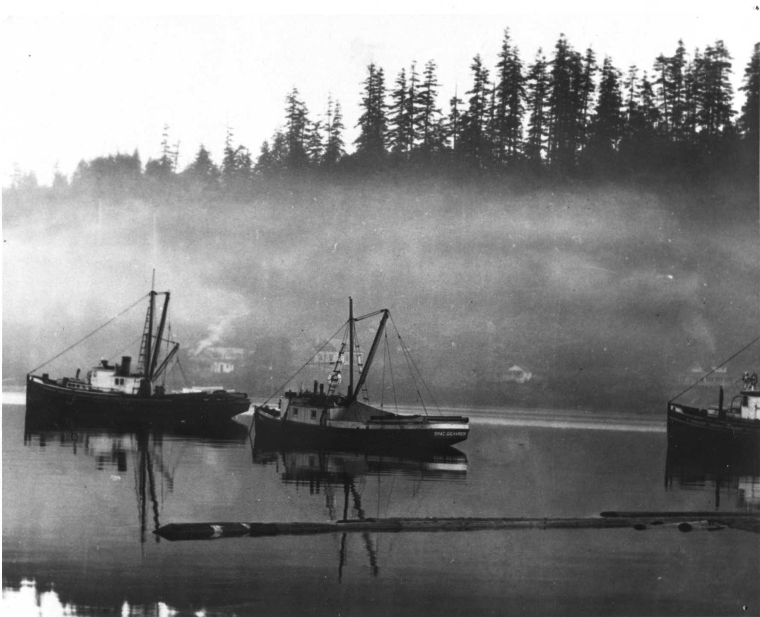
fish + trees + skills = maritime culture
Notes:
The boat in the middle was named the Brac’

Slide 13
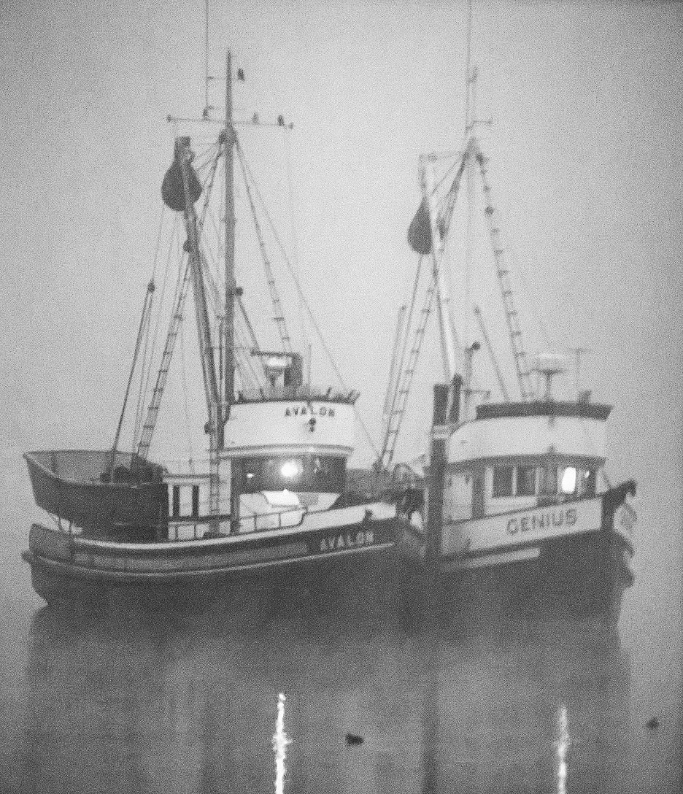
resources + ambition + skills = economic boom
bigger boats… bigger nets…
bigger engines!
But was it sustainable?
Notes:
Did they ever think that the resources would disappear? Did they ever understand how much their culture depended upon natural resources?

Slide 15
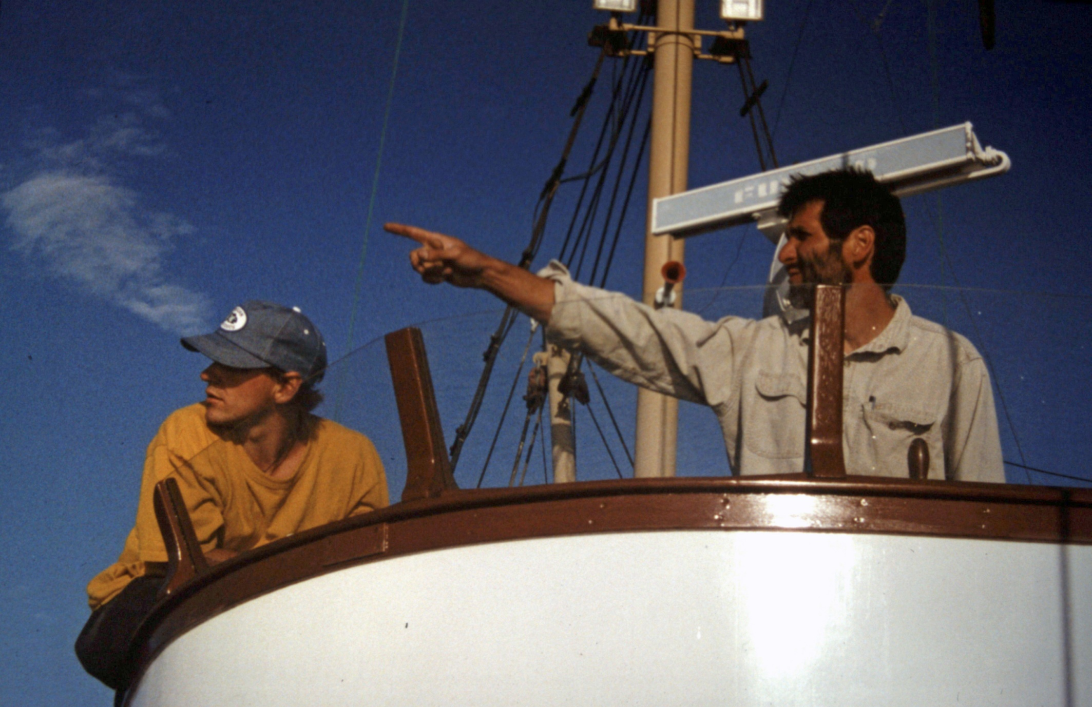
changing conditions - time to go another direction
But which way should I go?
Notes:
I loved boat building and commercial fishing, but they were no longer viable industries for me. Was I to be the last Vlahovich to carry on the family`s Croatian maritime heritage? What about our children, how will they now remain connected to our rich maritime traditions --- in books and photographs? Will they ever hear the stories told around the galley table? Will they ever know what it`s like to feel responsible to learn and transfer generations of tradition maritime knowledge? These were the questions that I wrestled with.

Slide 16
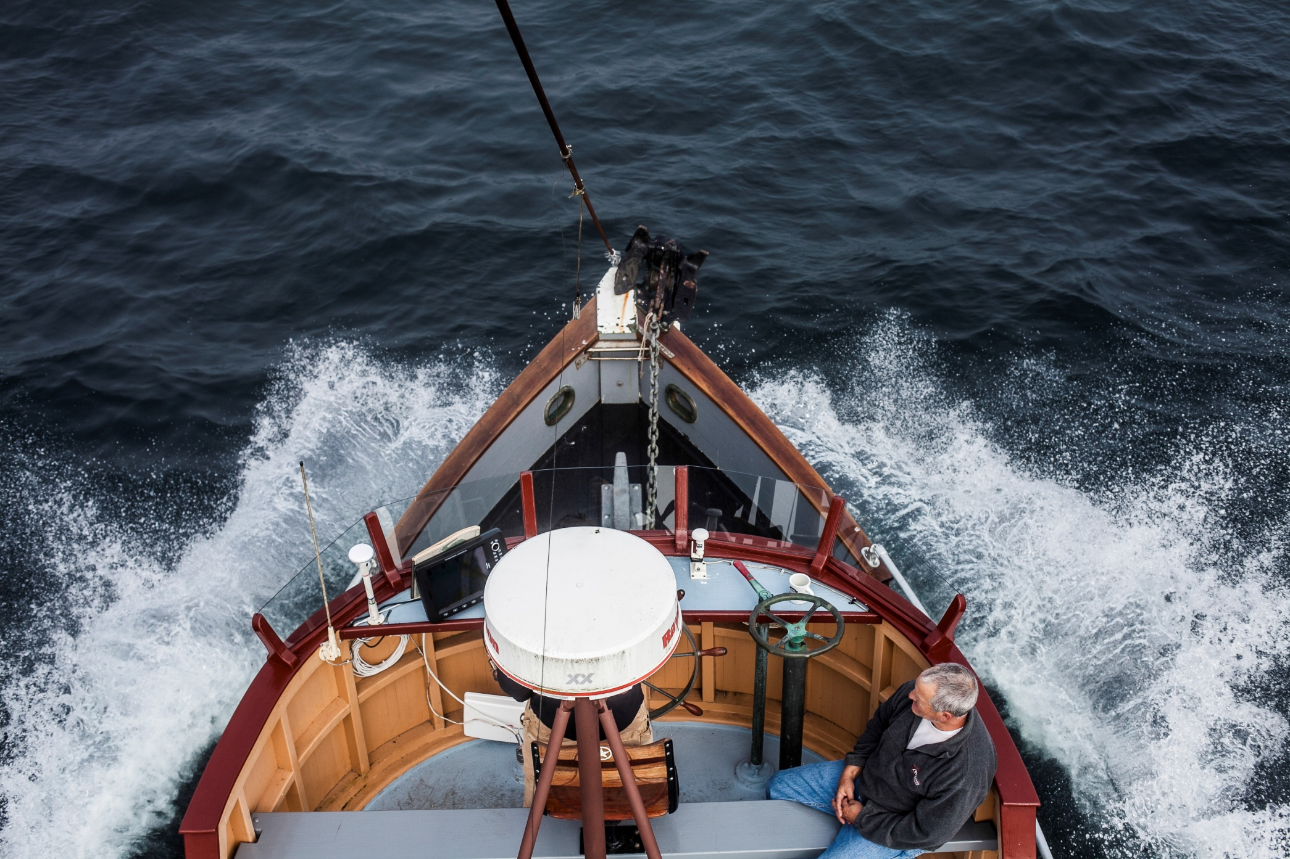
set a new direction – create a new mission
Notes:
I set out on a voyage of discovery

Slide 17
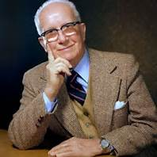
engage in transformative action
“You never change things by fighting the existing reality. To change something; build a new model that makes the existing model obsolete.”
Buckminster Fuller
thinking beyond current systems & outdated models

Slide 18
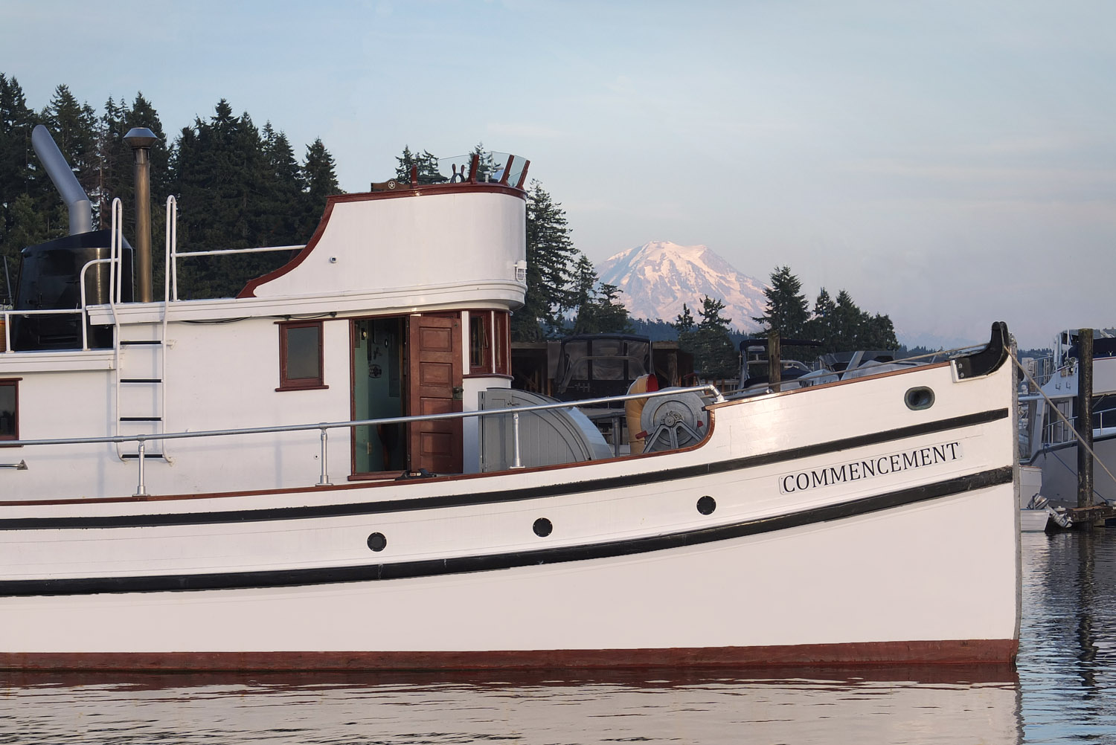
give new life to old meanings
Notes:
I knew that I did not want to change the “old meanings” of my heritage – those values, principles, ethics and rituals, but I also knew that I needed to create a new and different delivery system. I attempted to blend in with the mainstay practices of maritime museums and festivals, but found that their system of collecting. cataloging, displaying and interpreting objects was insufficient in actually sustaining threatened cultures.

Slide 19
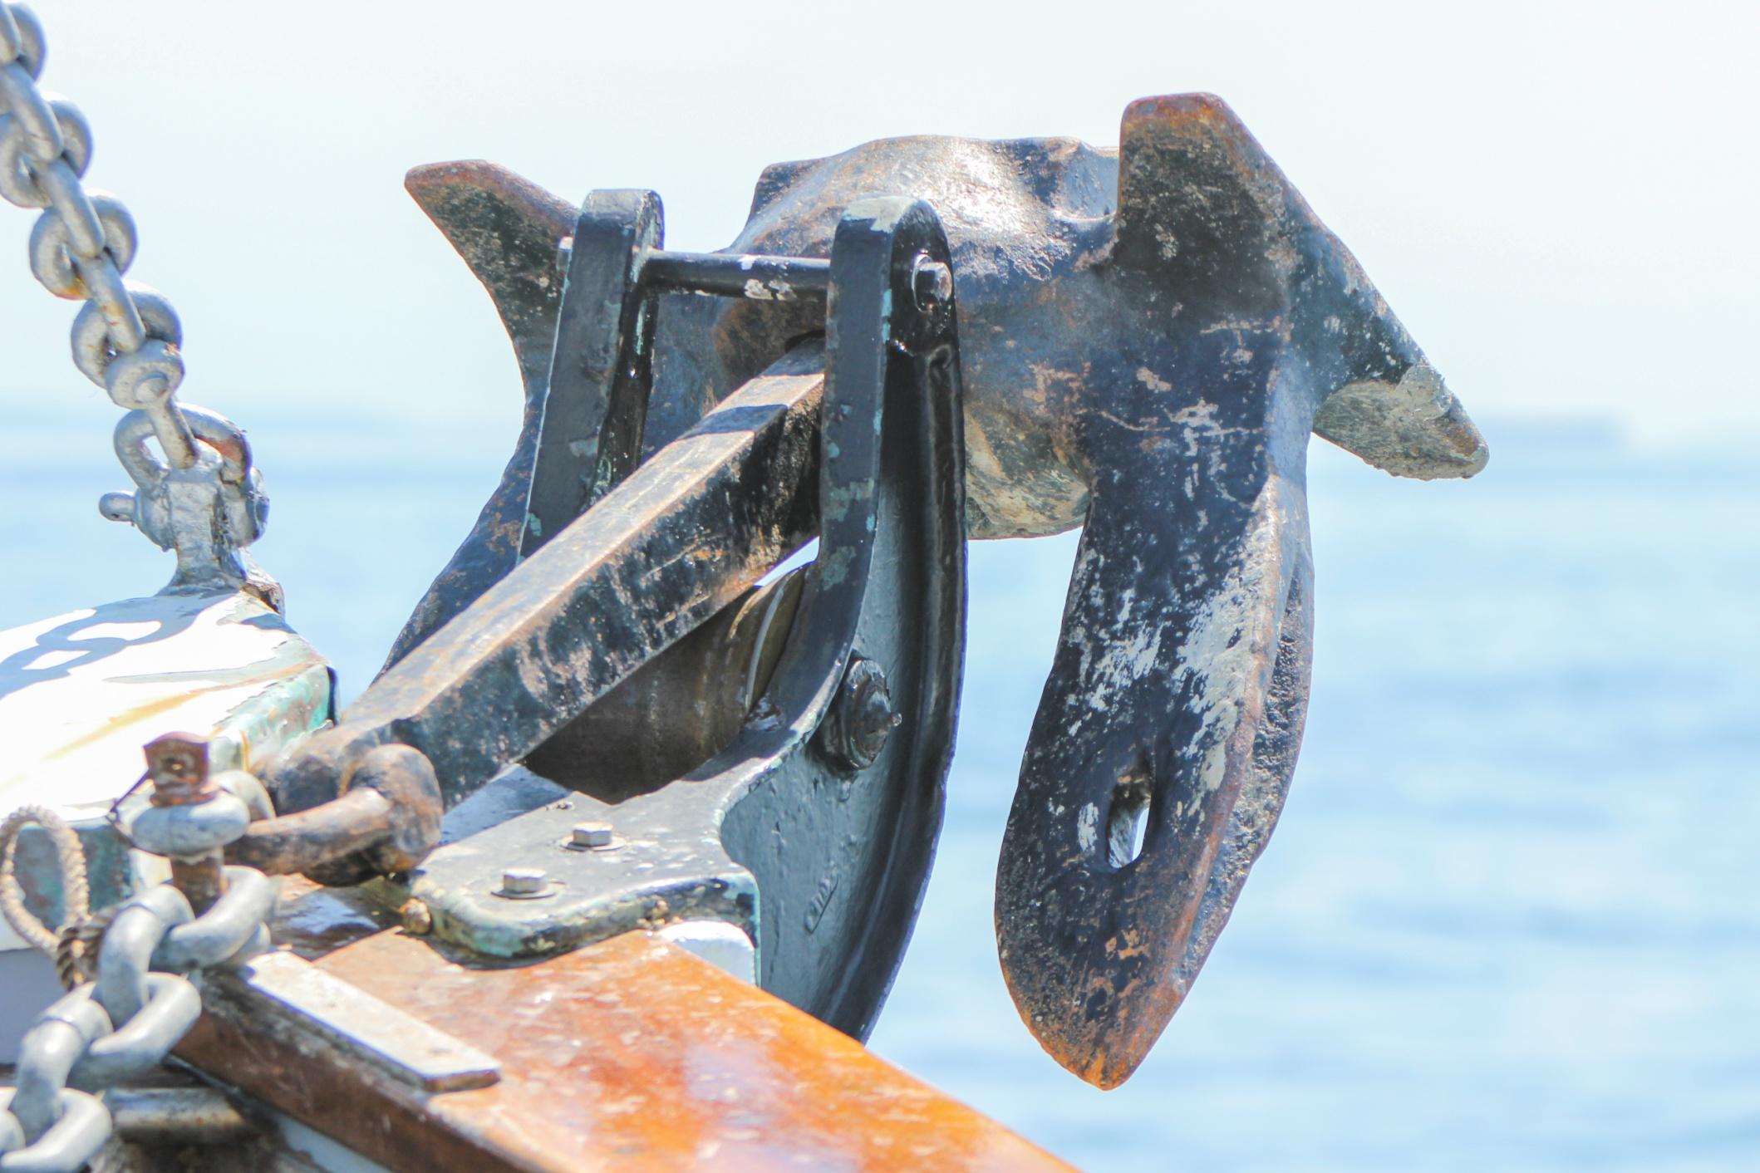
heritage was our anchor
Notes:
So

Slide 20
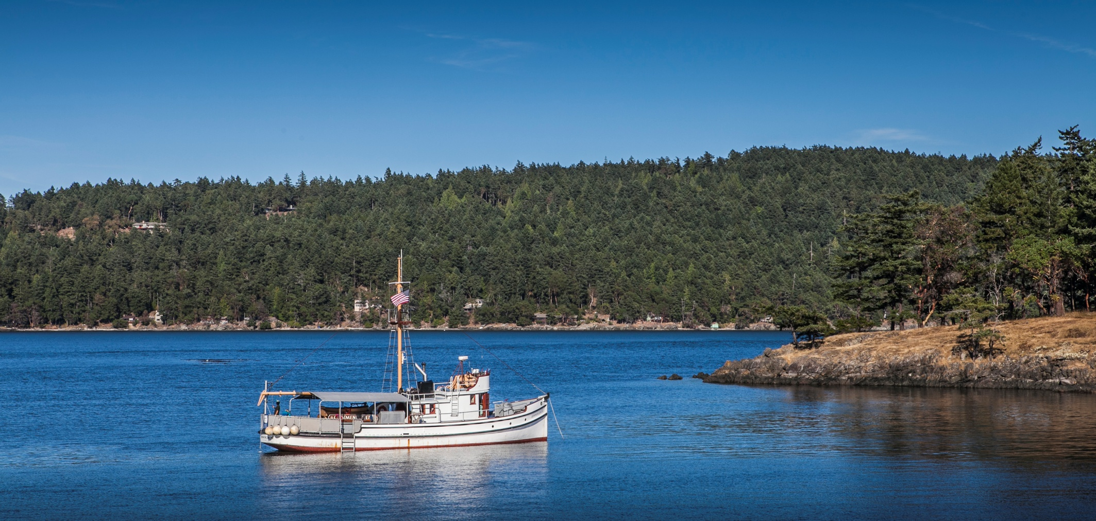
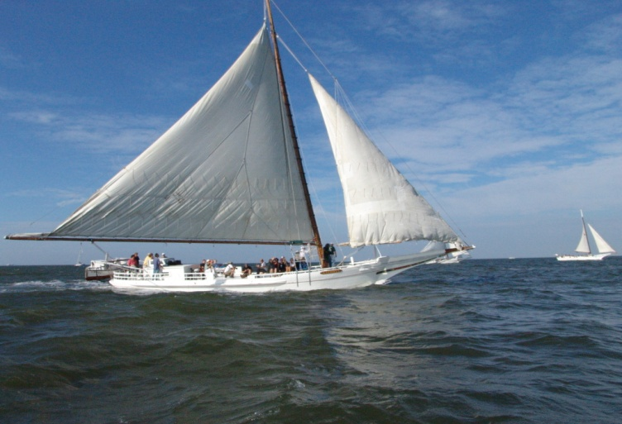
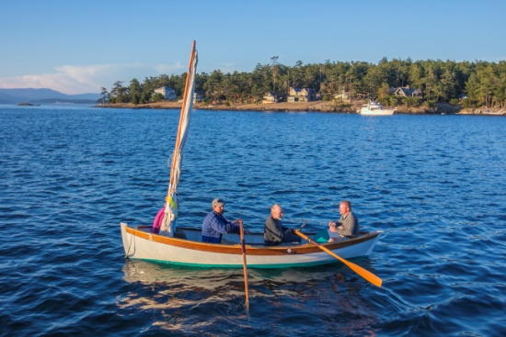
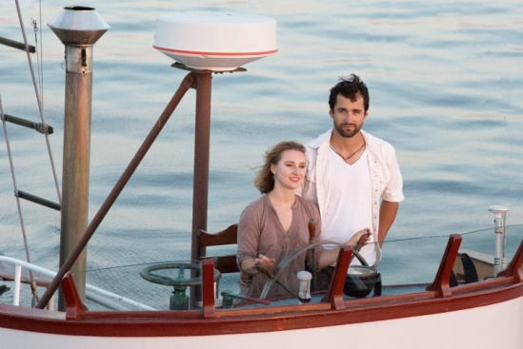
seafaring was our culture

Slide 21
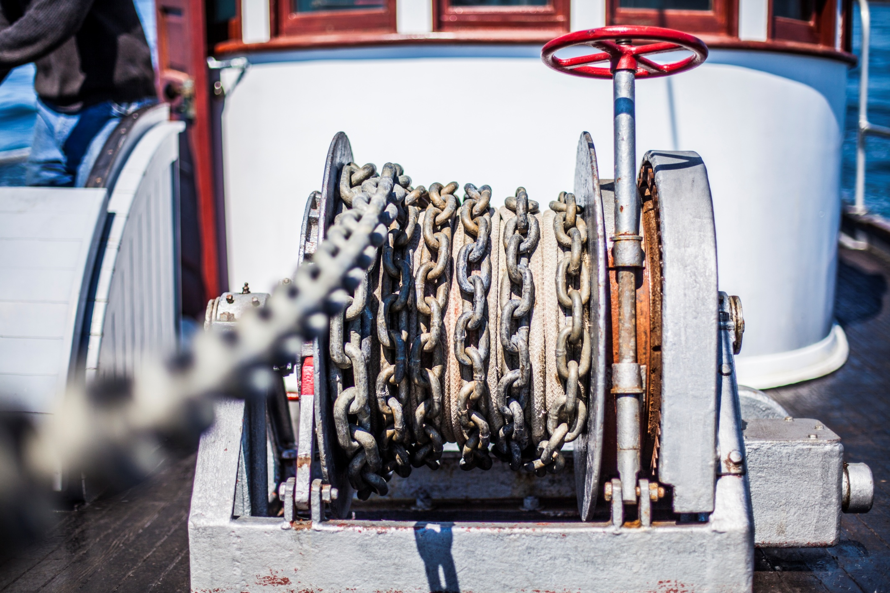
heritage & culture need to remain chained together
Notes:
The challenge therefore is how do we connect our heritage of the past with our culture of today? How do we best sustain, support & protect those elements of “living traditions” in the face of changing times?

Slide 22
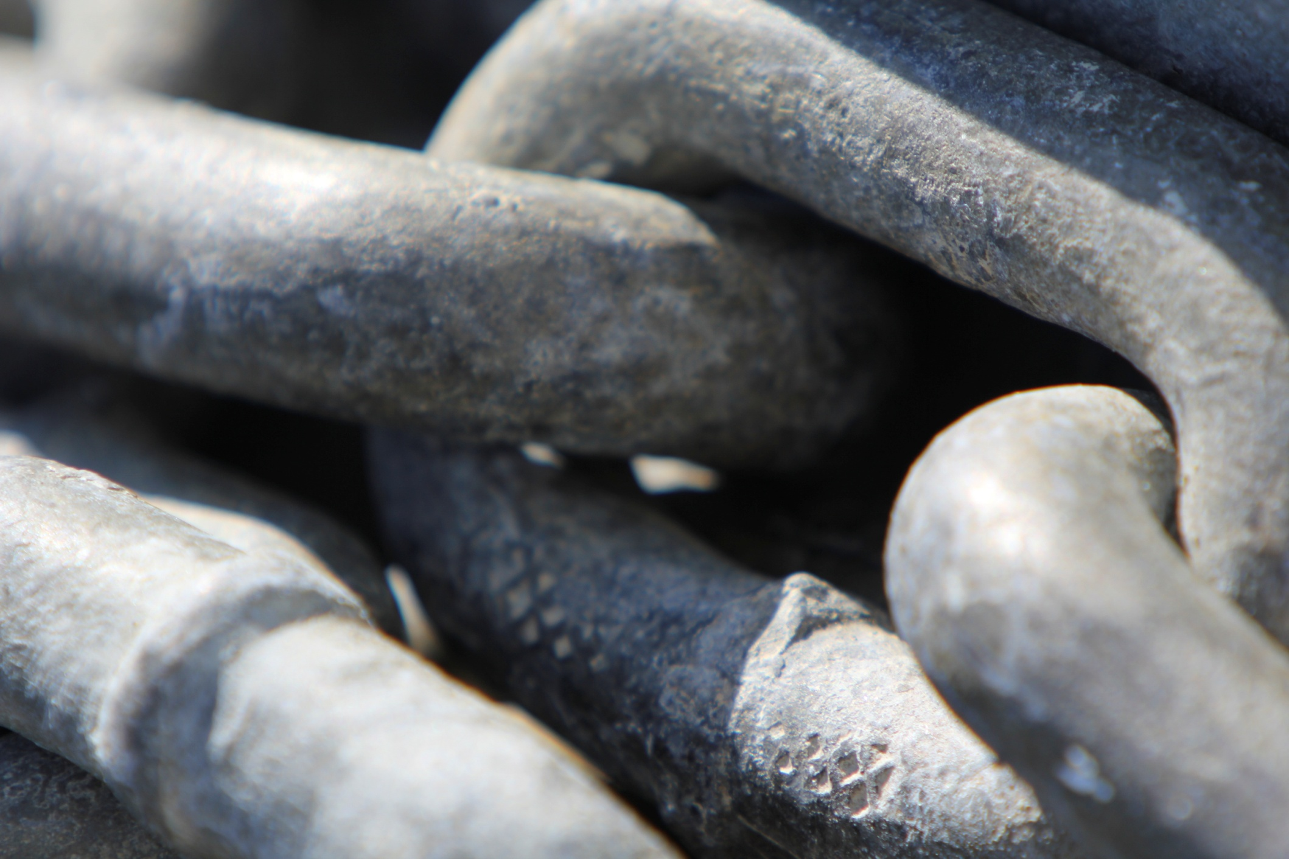
and we are the links that form that chain
Notes:
What role can we play? What role can you play in connecting the Croatian maritime heritage with your daily , with the life of visitors, with the life of children And young adults? Is the chain strong enough to survive the sea conditions – the currents and tides – the storms and the ware and tare of modern living?

Slide 23
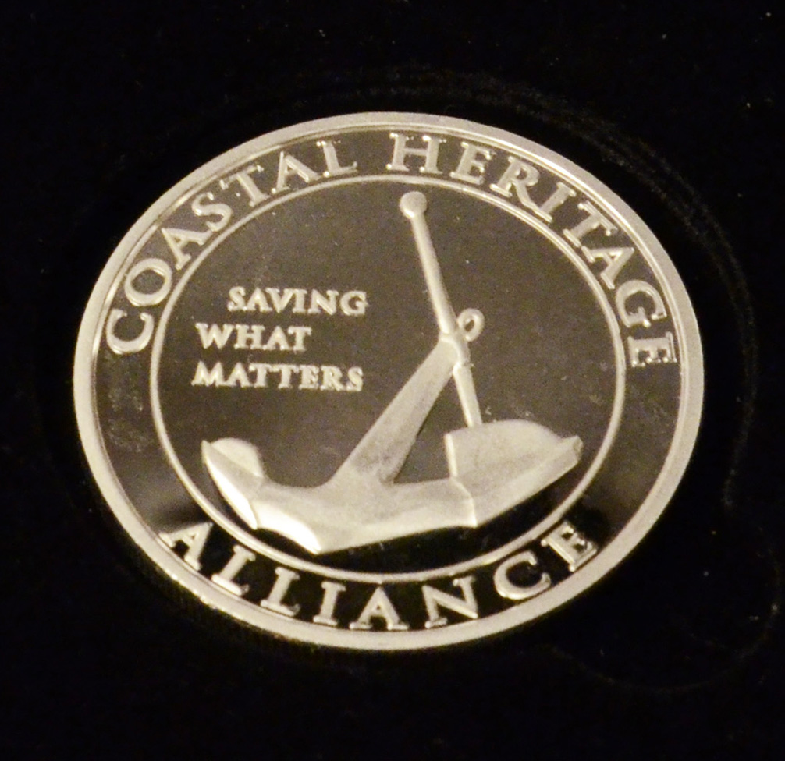
a new model

Slide 24
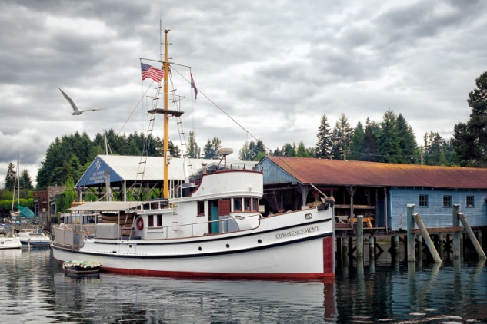
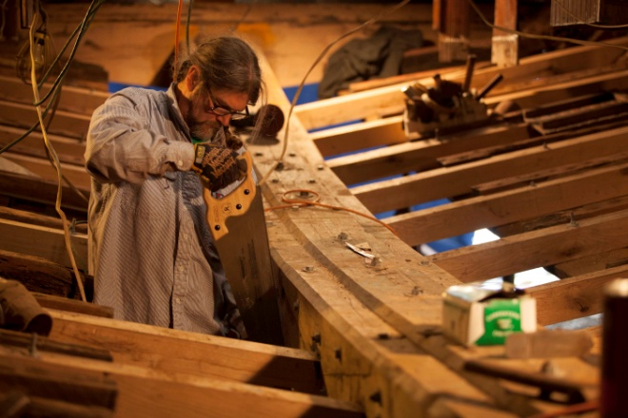
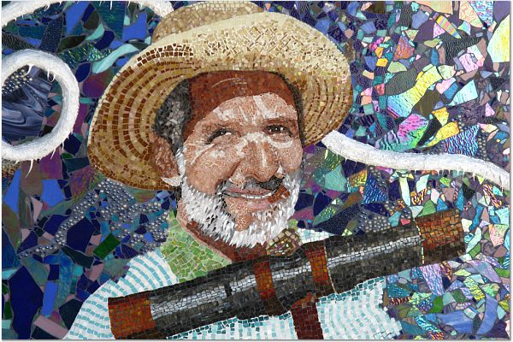
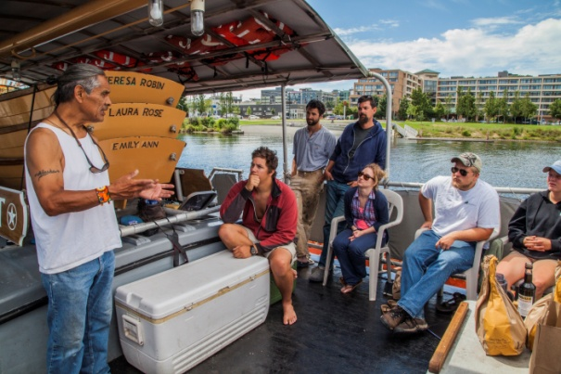
Built on real experience
working in the field of maritime occupations, historic preservation, traditional skill training and heritage tourism.
The Vessels
The Skills
Mike V. Mosaic,
National Harbor Washington DC
The Stories
Notes:
Who I represent, who I work for

Slide 25
theory of action
transforming private heritage
into public programming...
Traditional Shipwright Apprenticeships
Cultural & Environmental Seafaring Education
Prison Inmate Training/Rehabilitation
Traveling Maritime Skill Demonstrations for Kids
Heritage Tourism Tour Guide Training for Fishermen
Museum Apprentice for a Day Programs
After School Youth Programs

Slide 26
Example #1: shipwright apprentice training

Slide 27
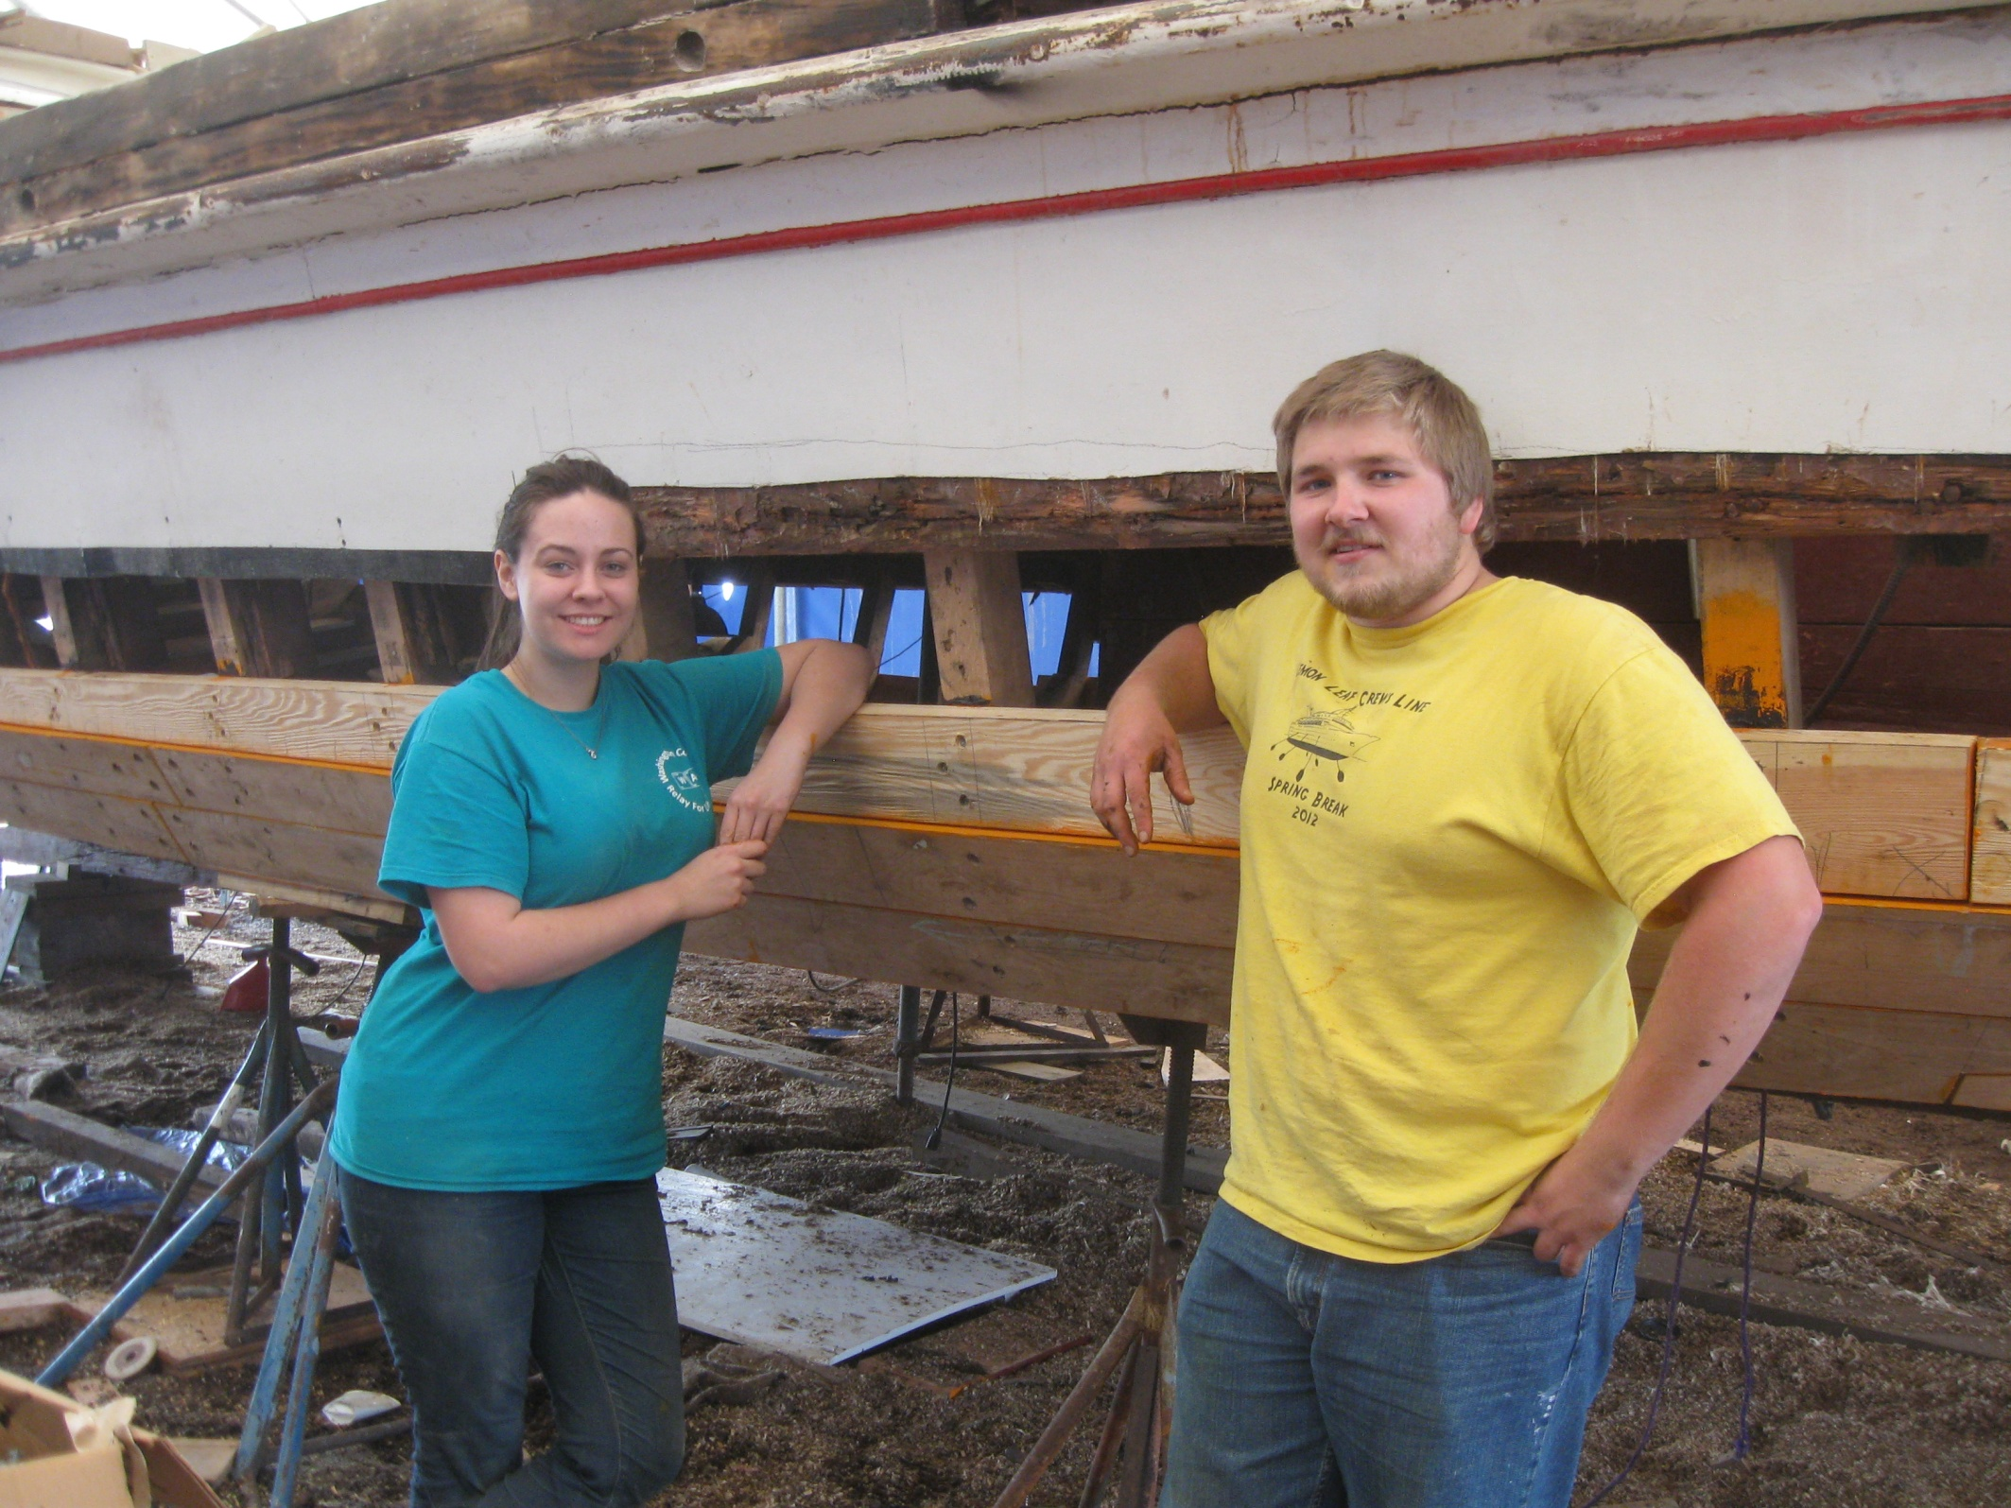

Slide 28
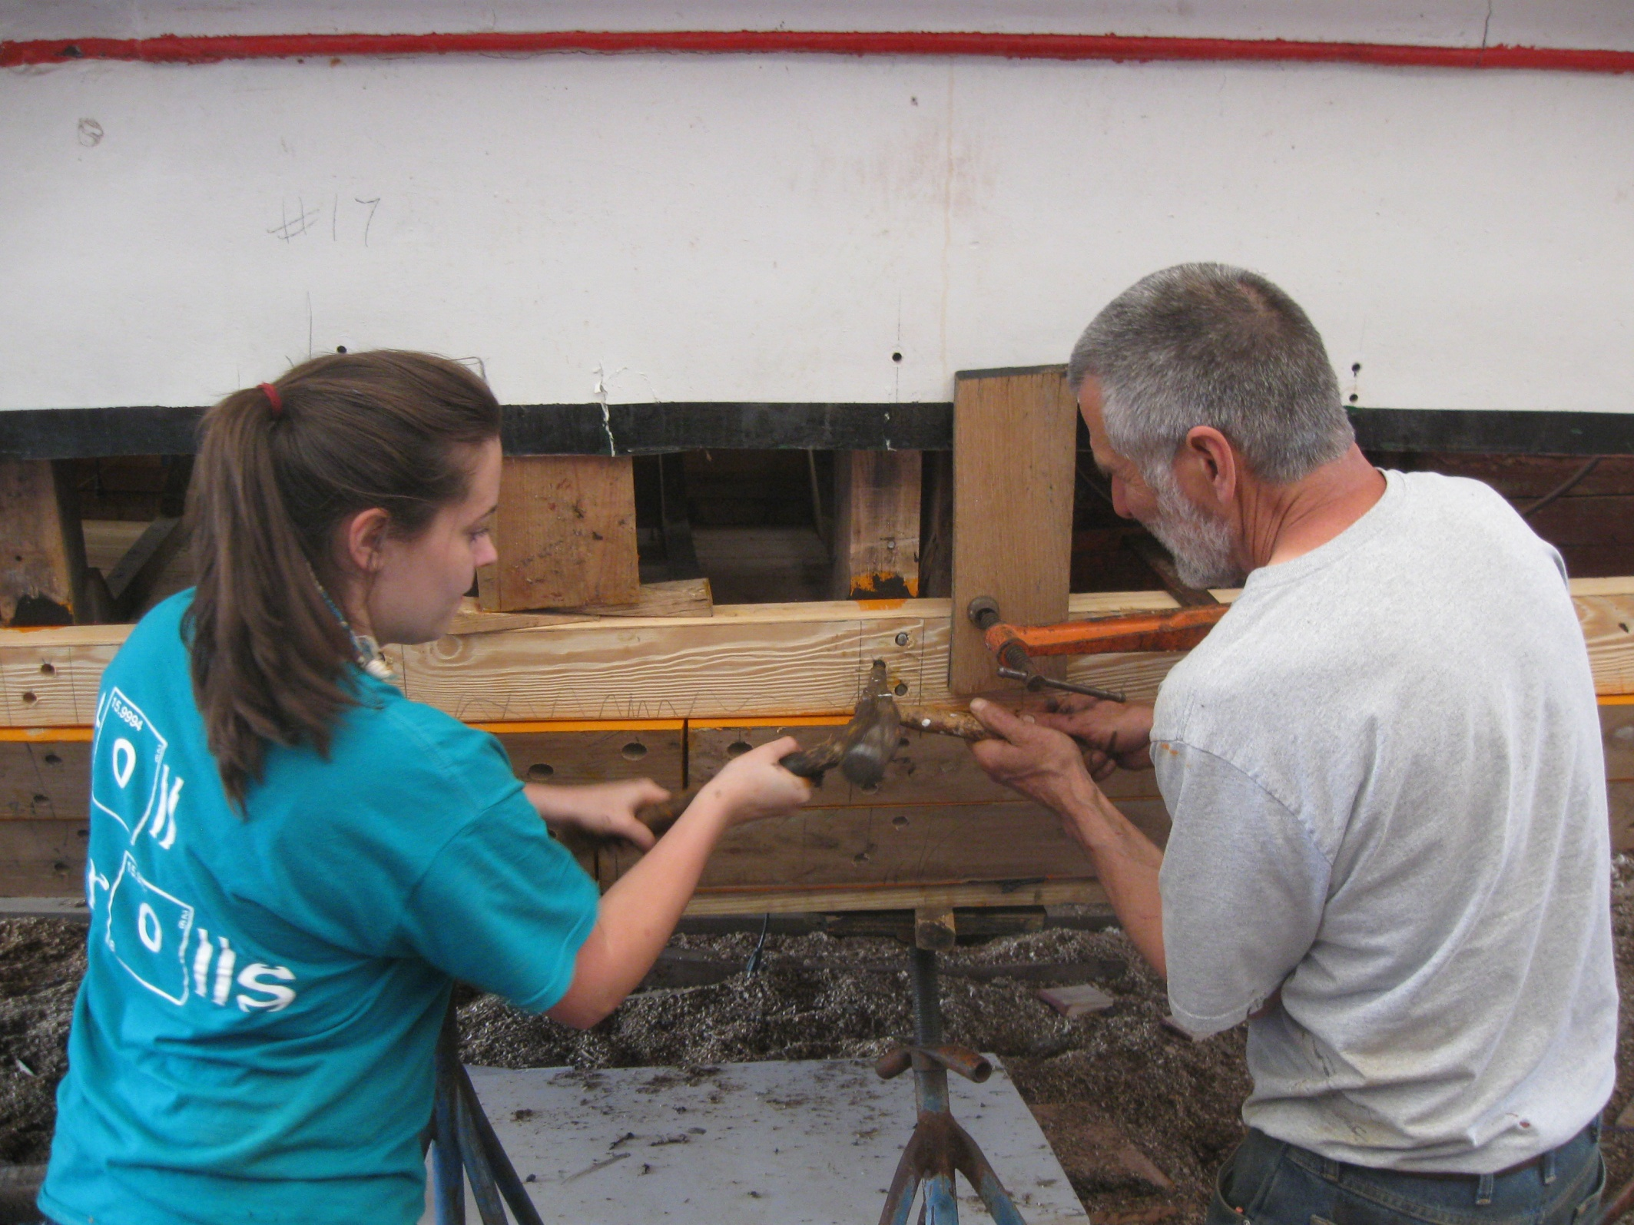

Slide 29
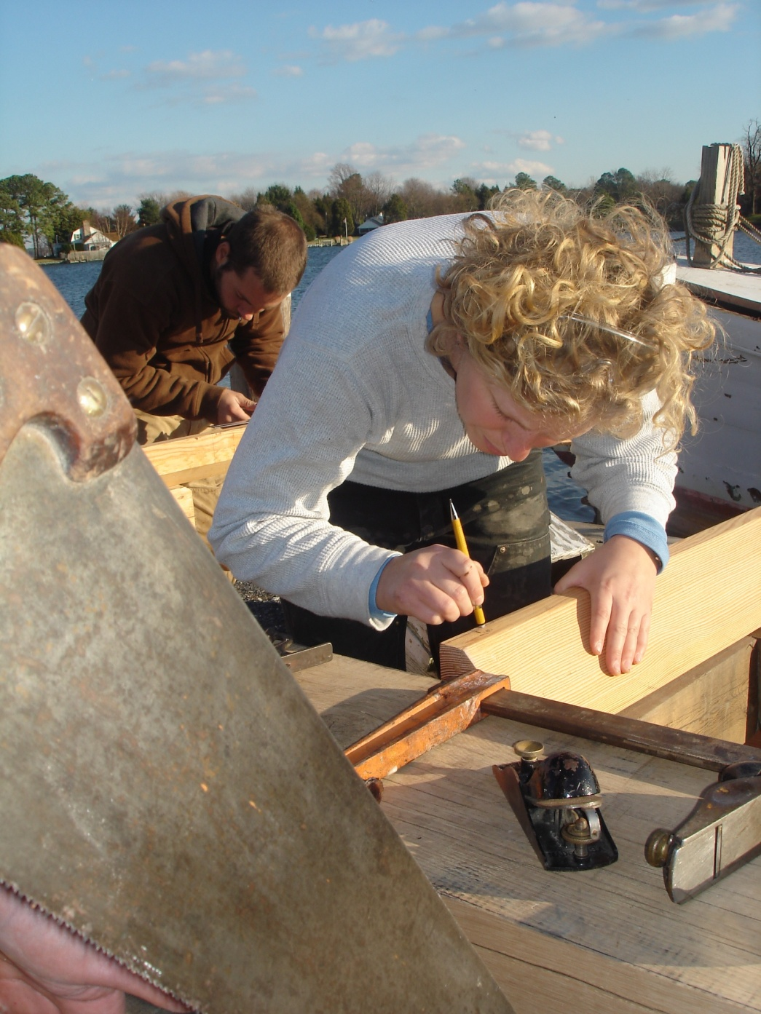
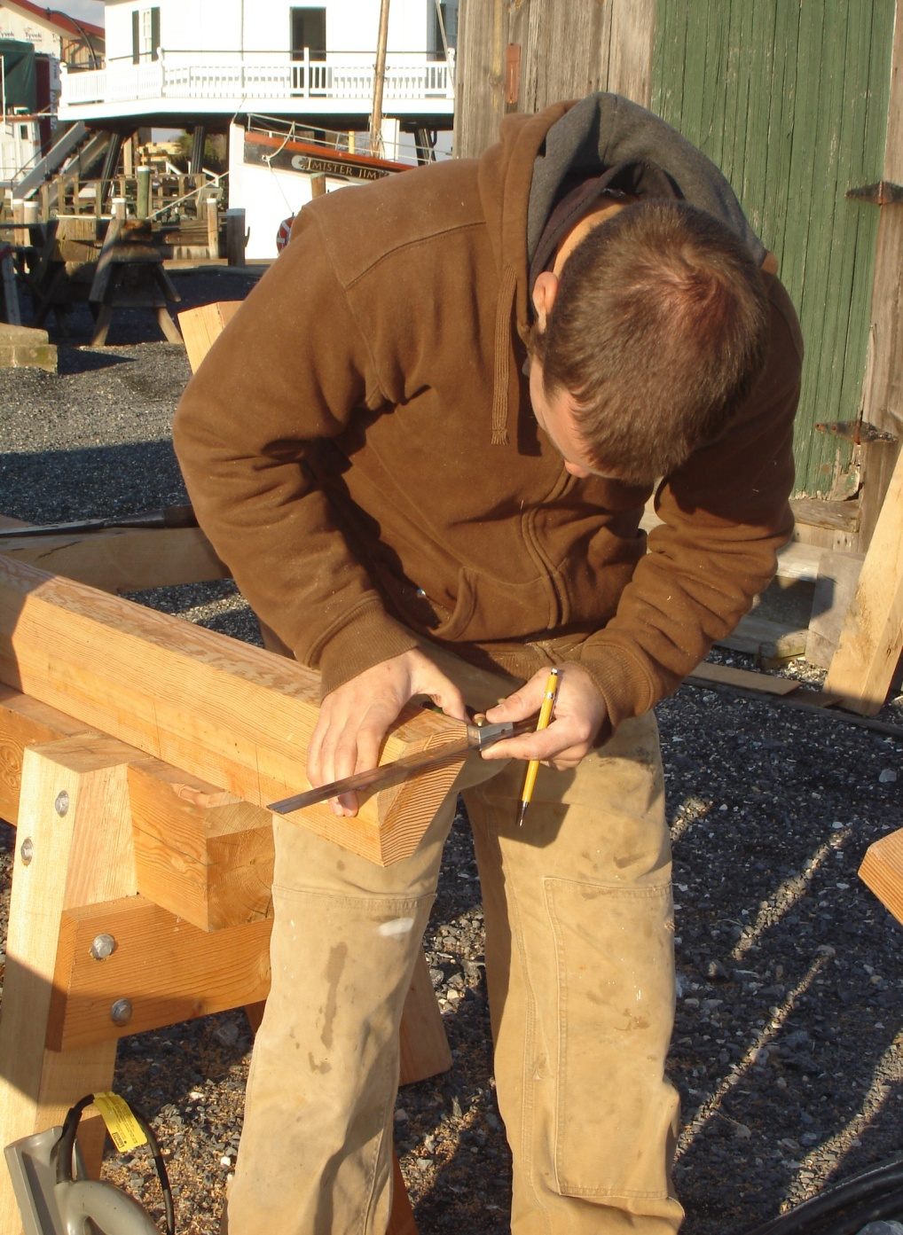

Slide 30
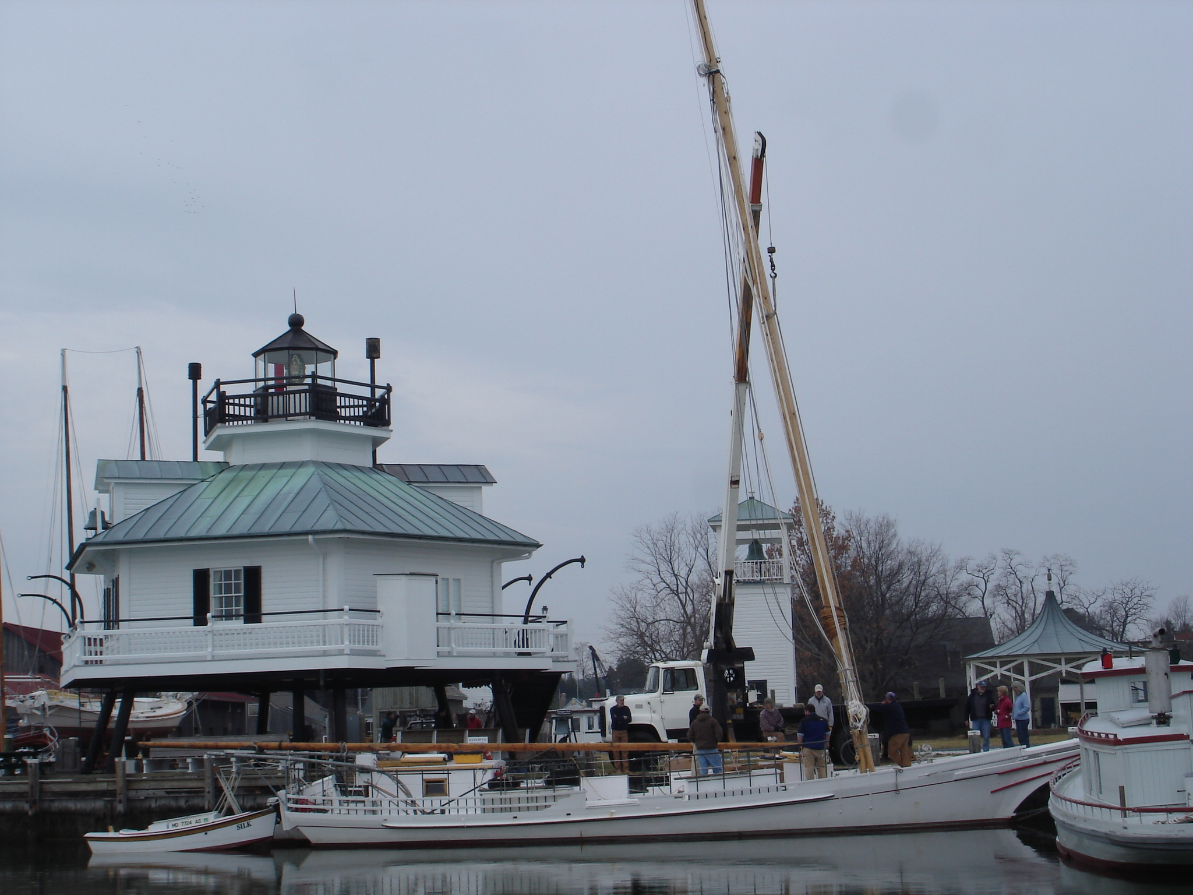

Slide 31
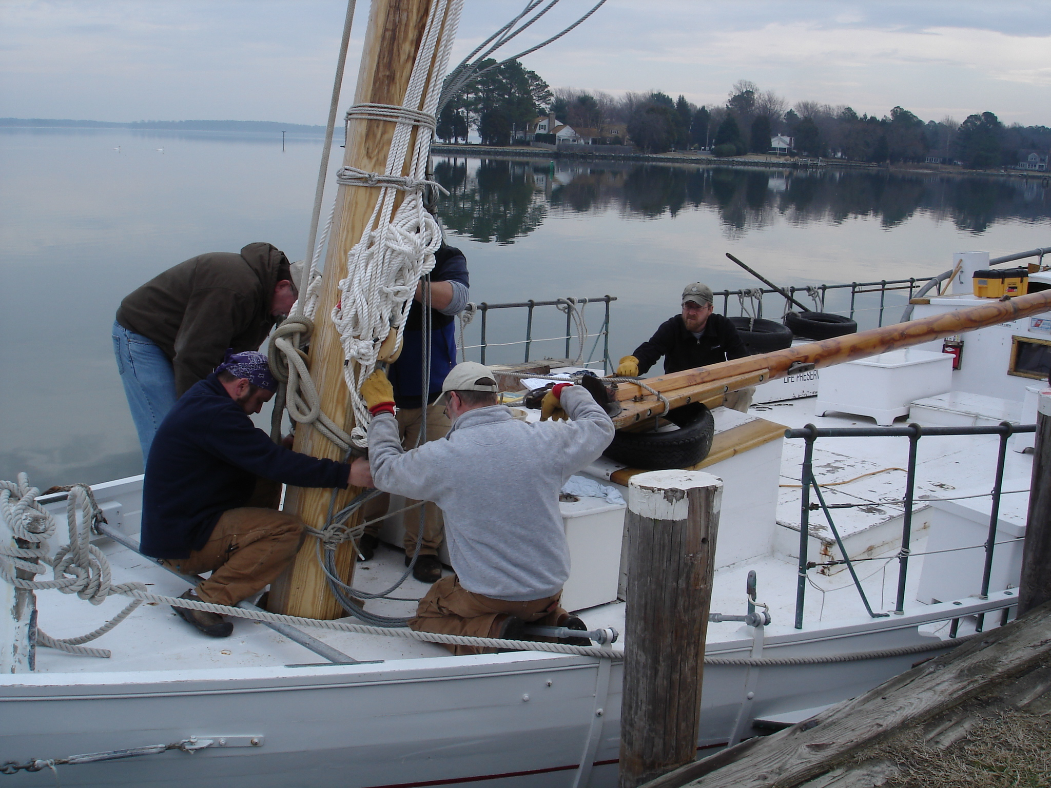

Slide 32
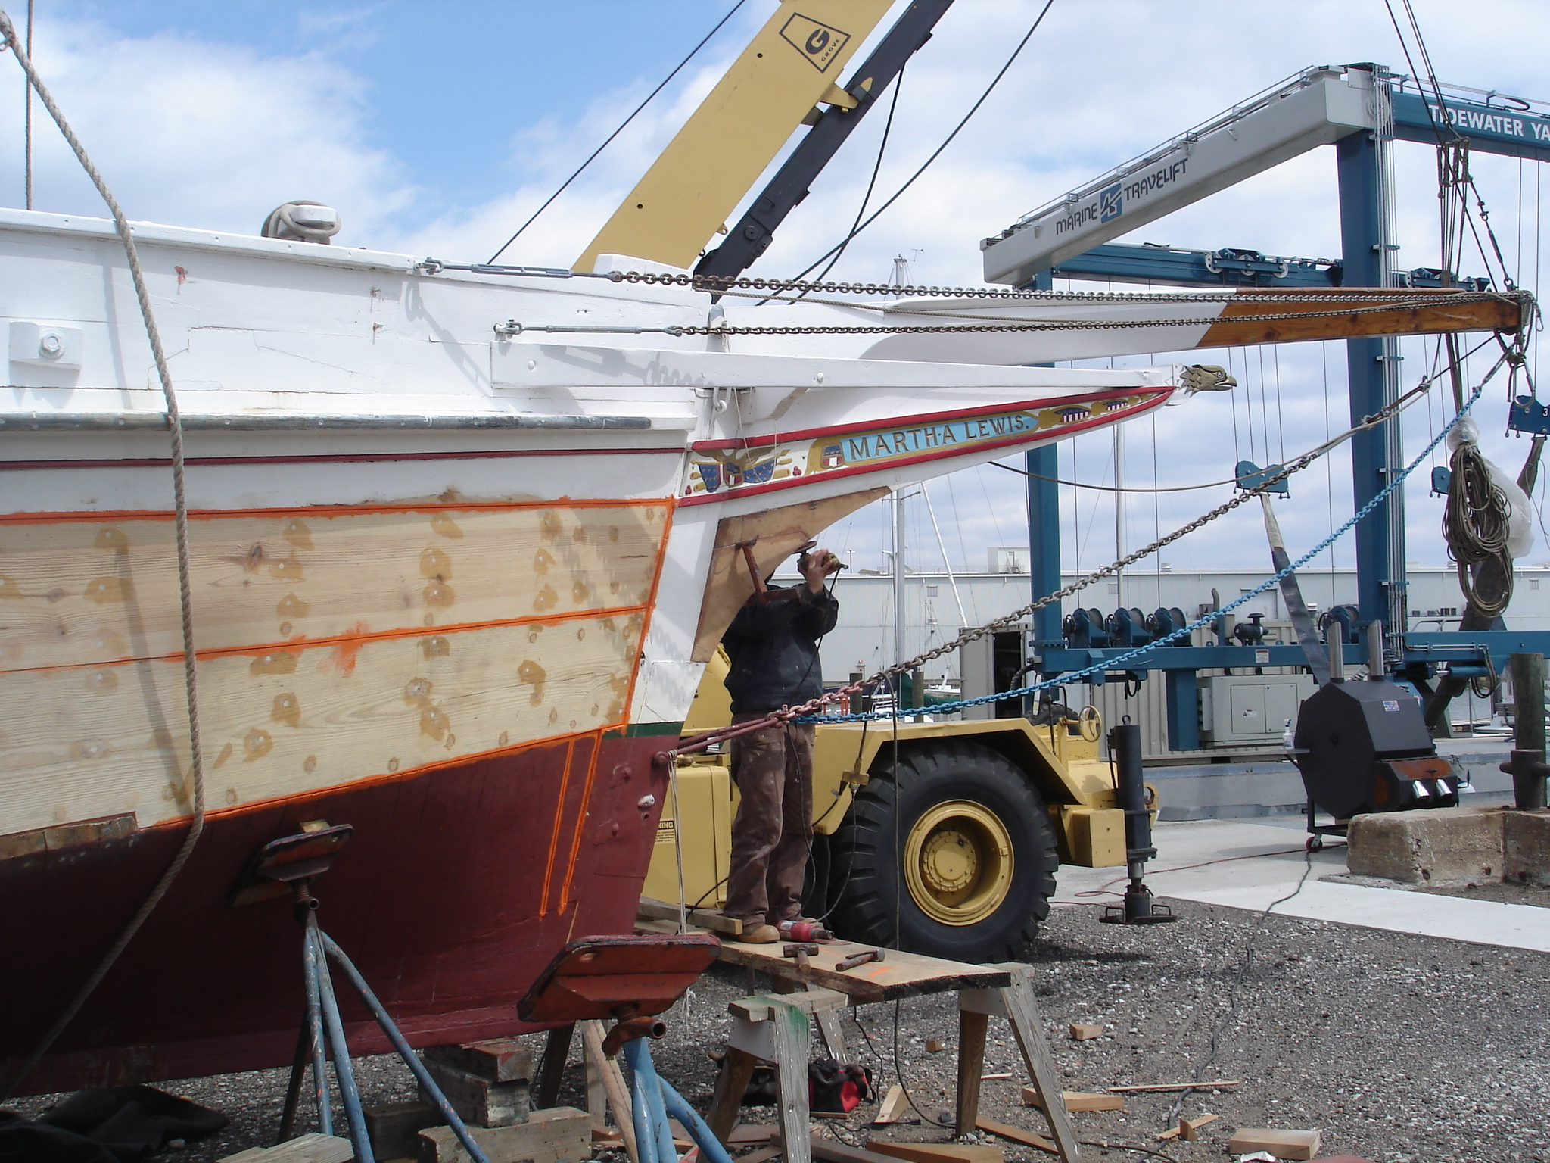

Slide 33
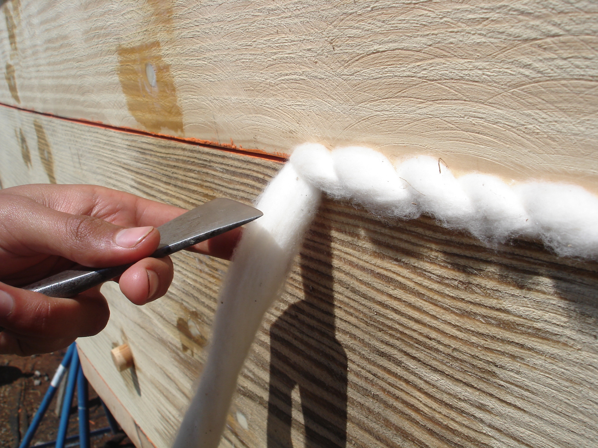

Slide 34
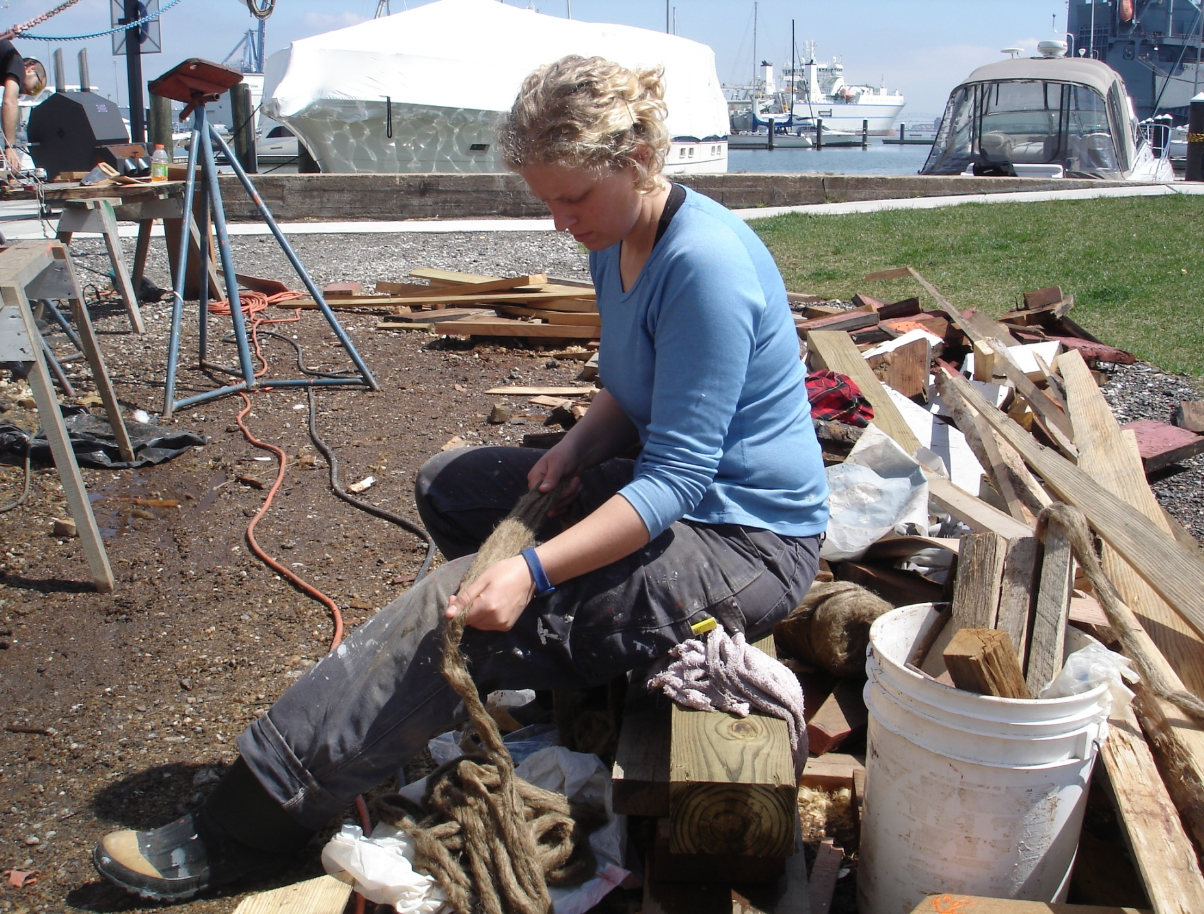

Slide 35
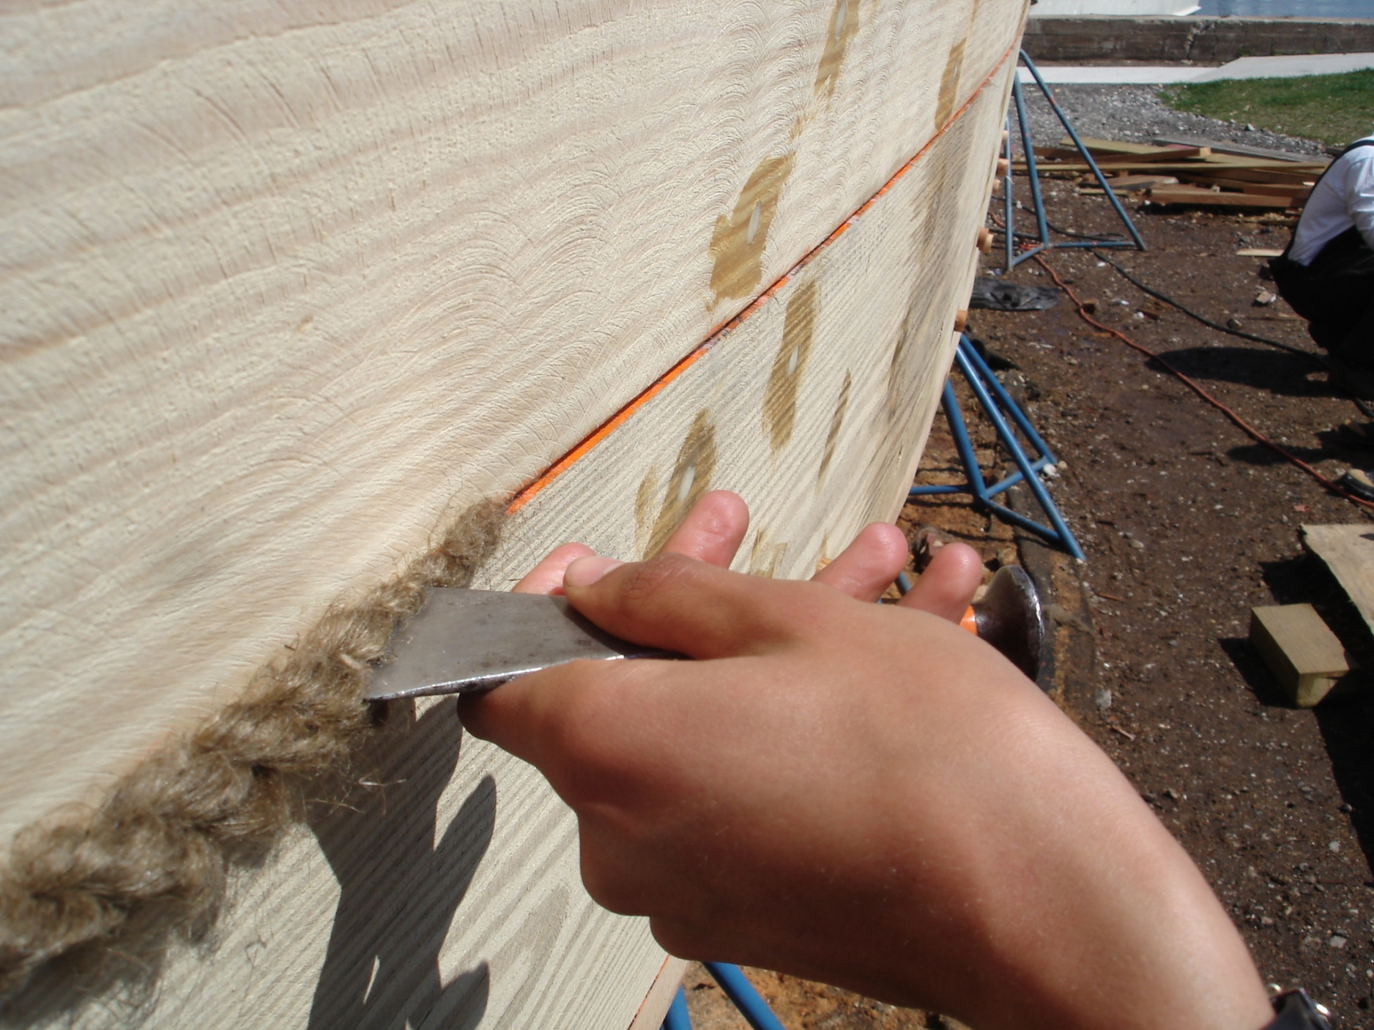

Slide 36
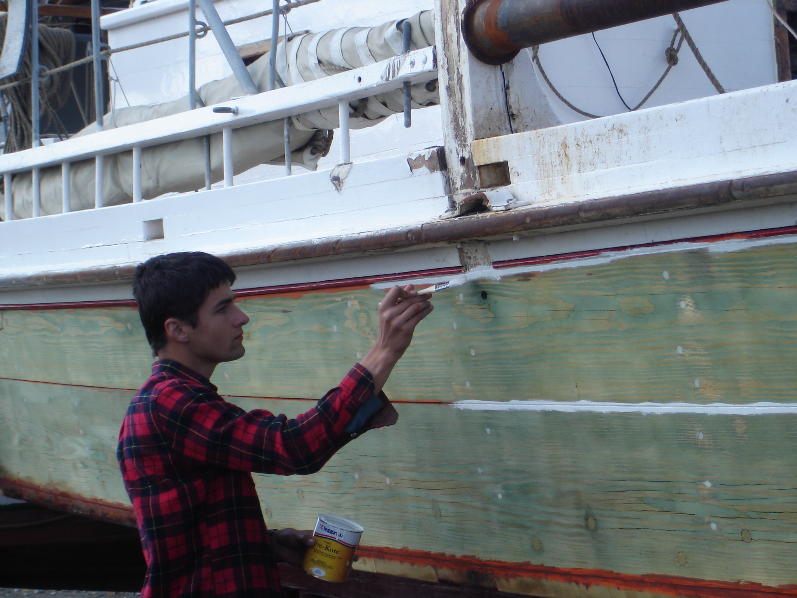

Slide 37
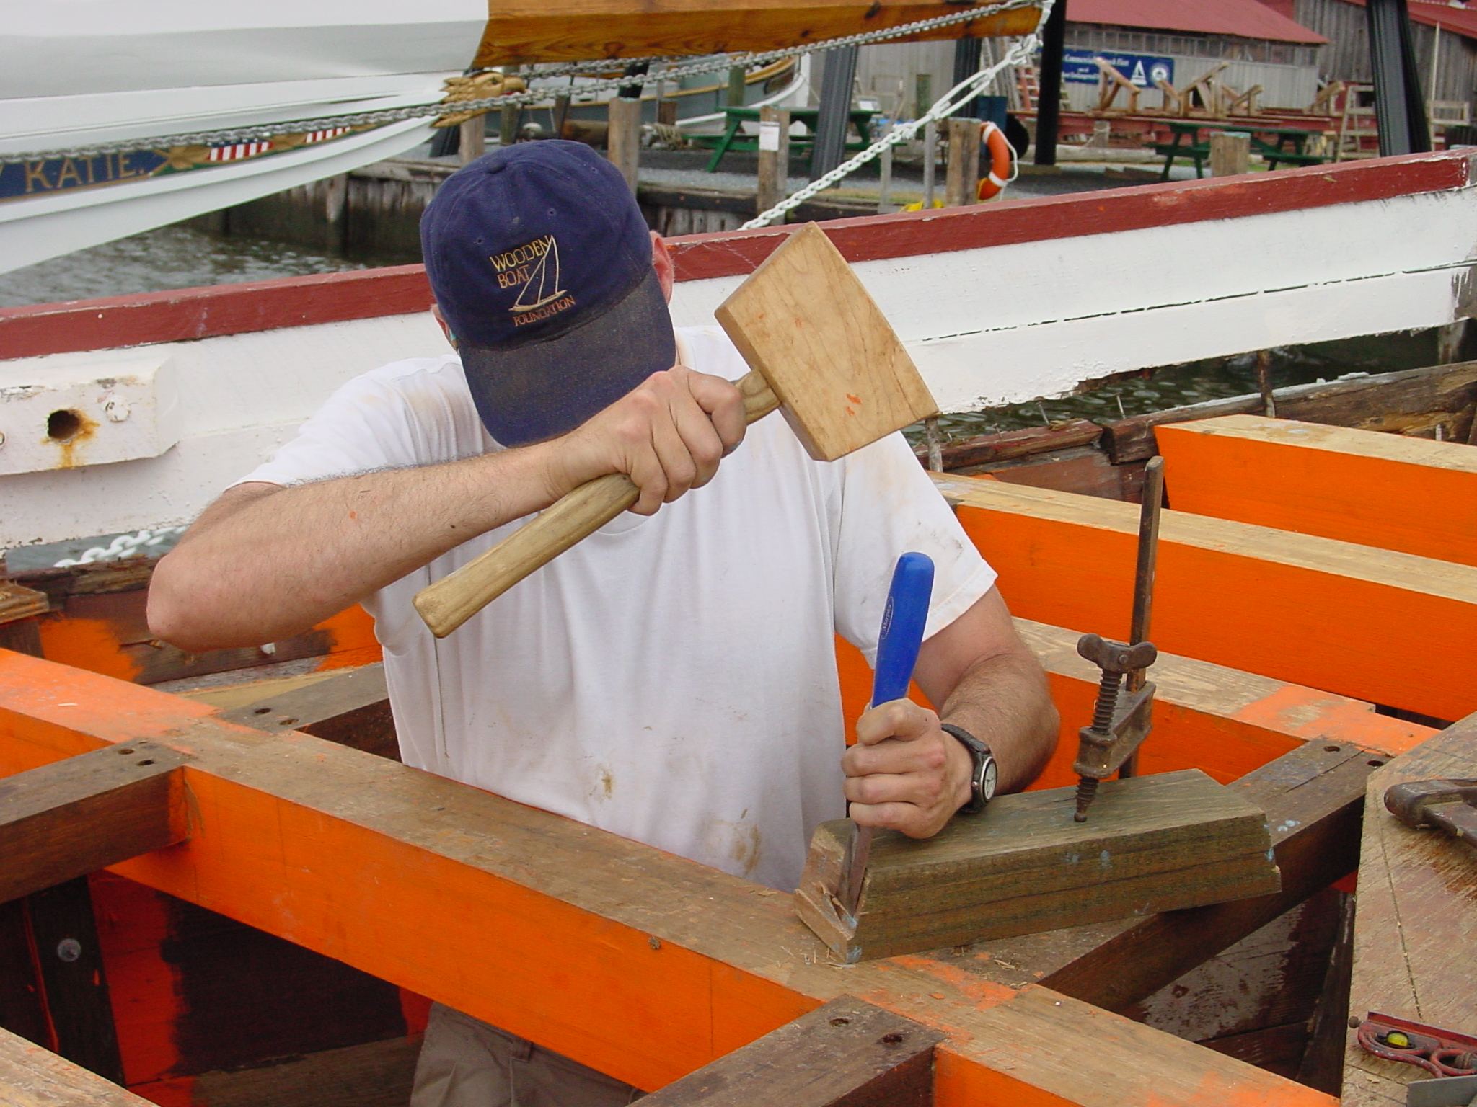

Slide 38
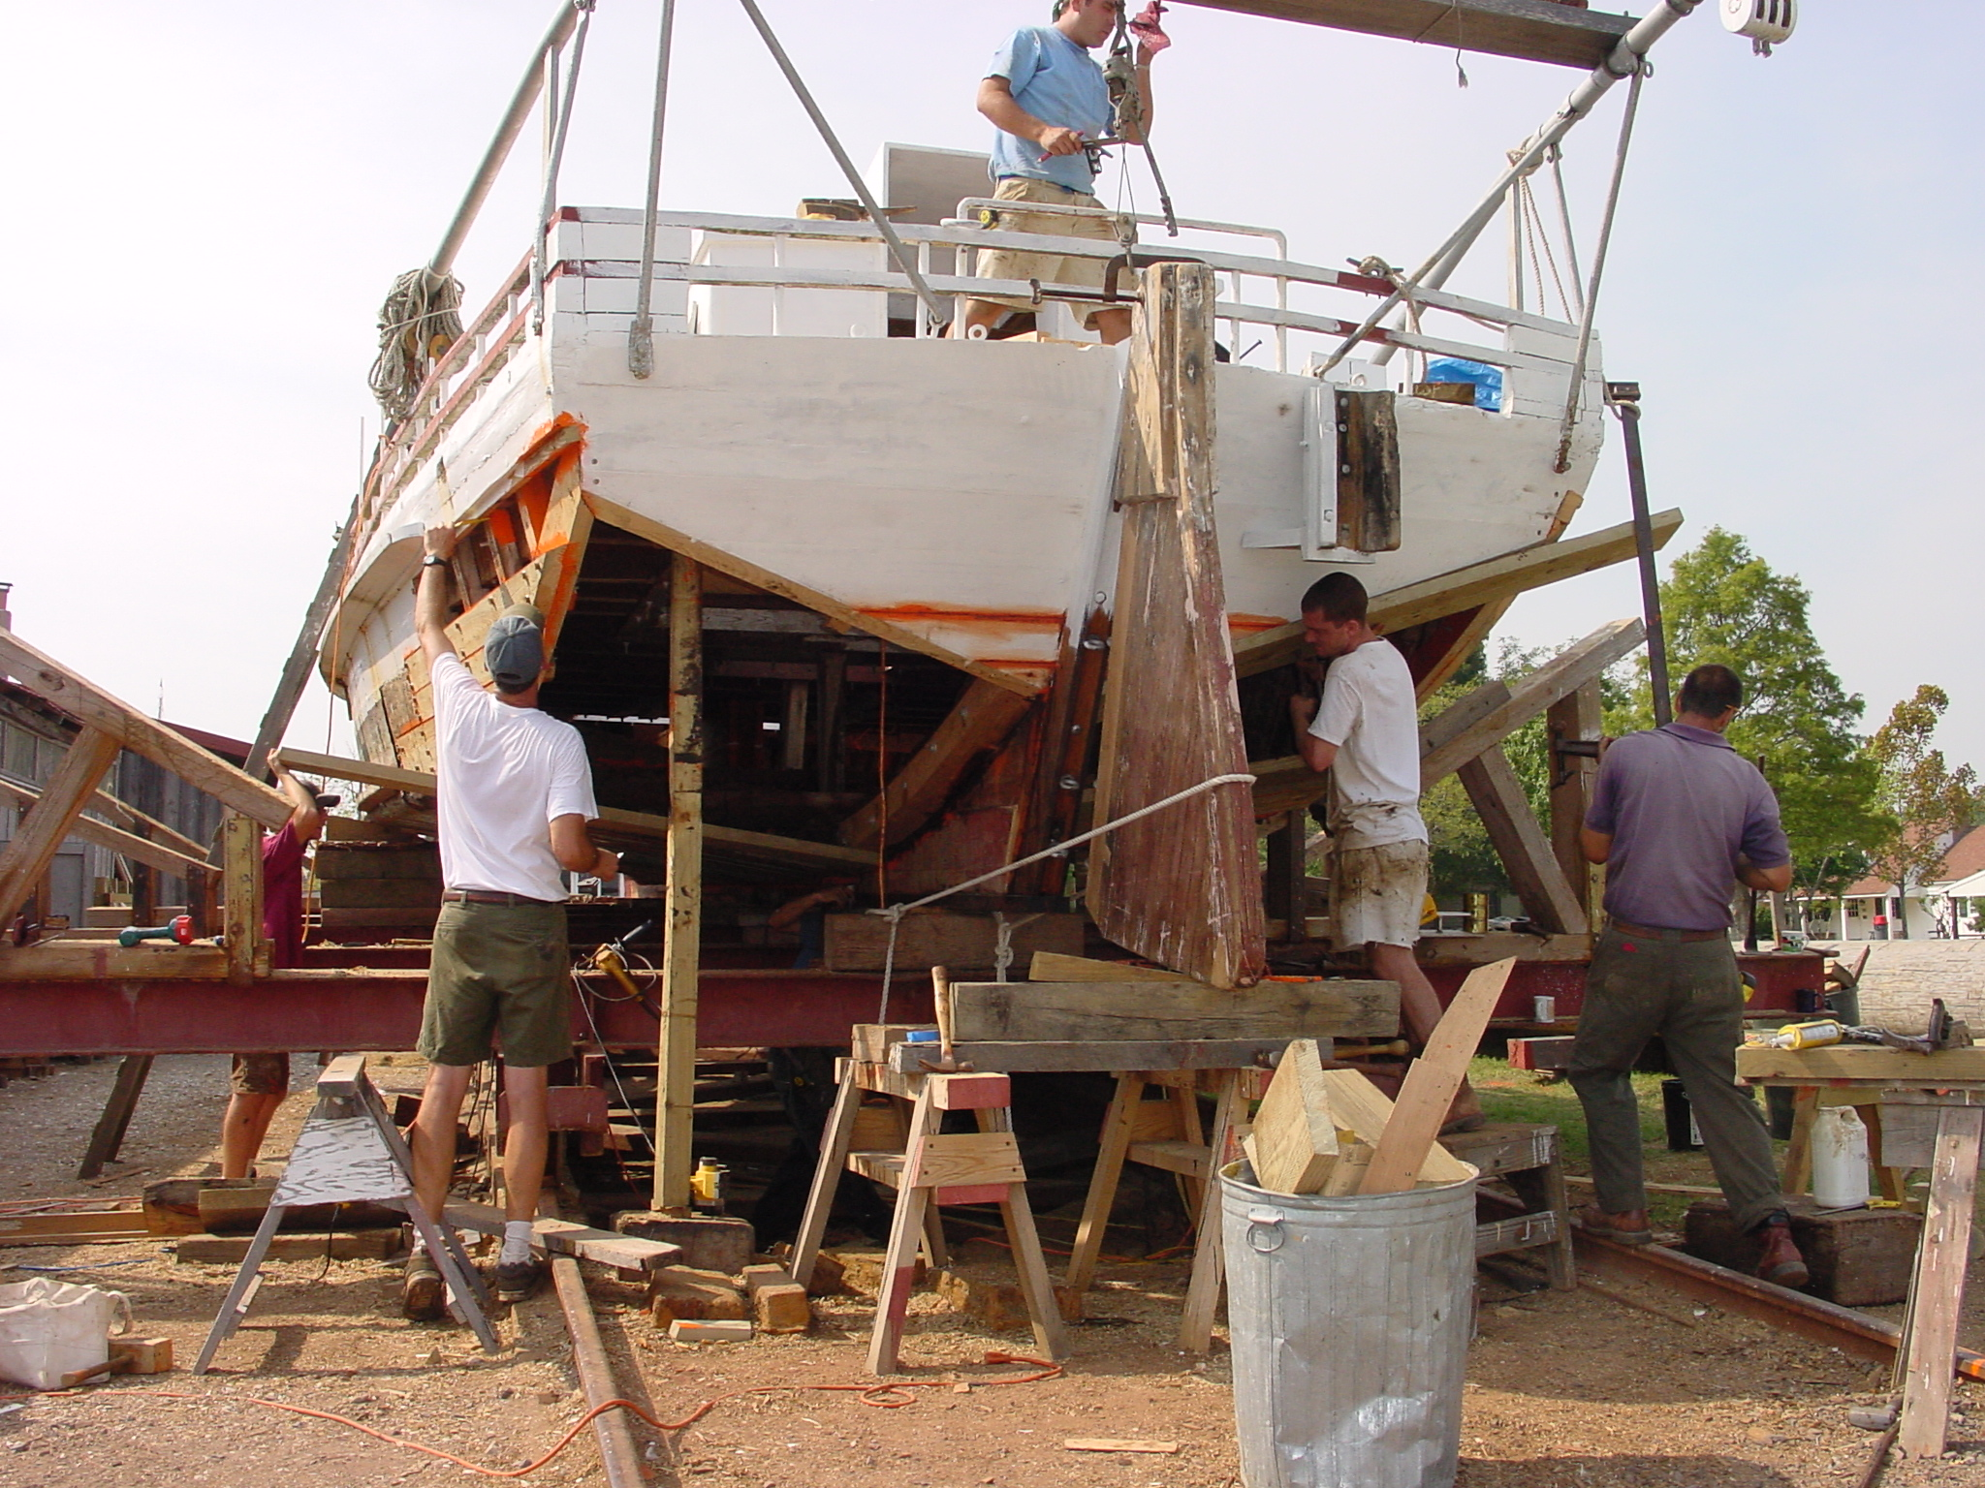

Slide 39
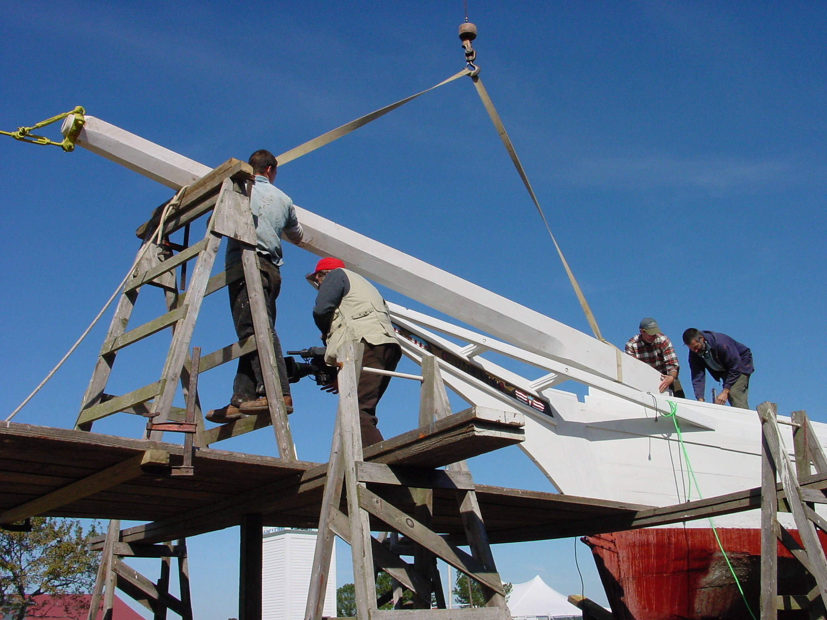

Slide 40
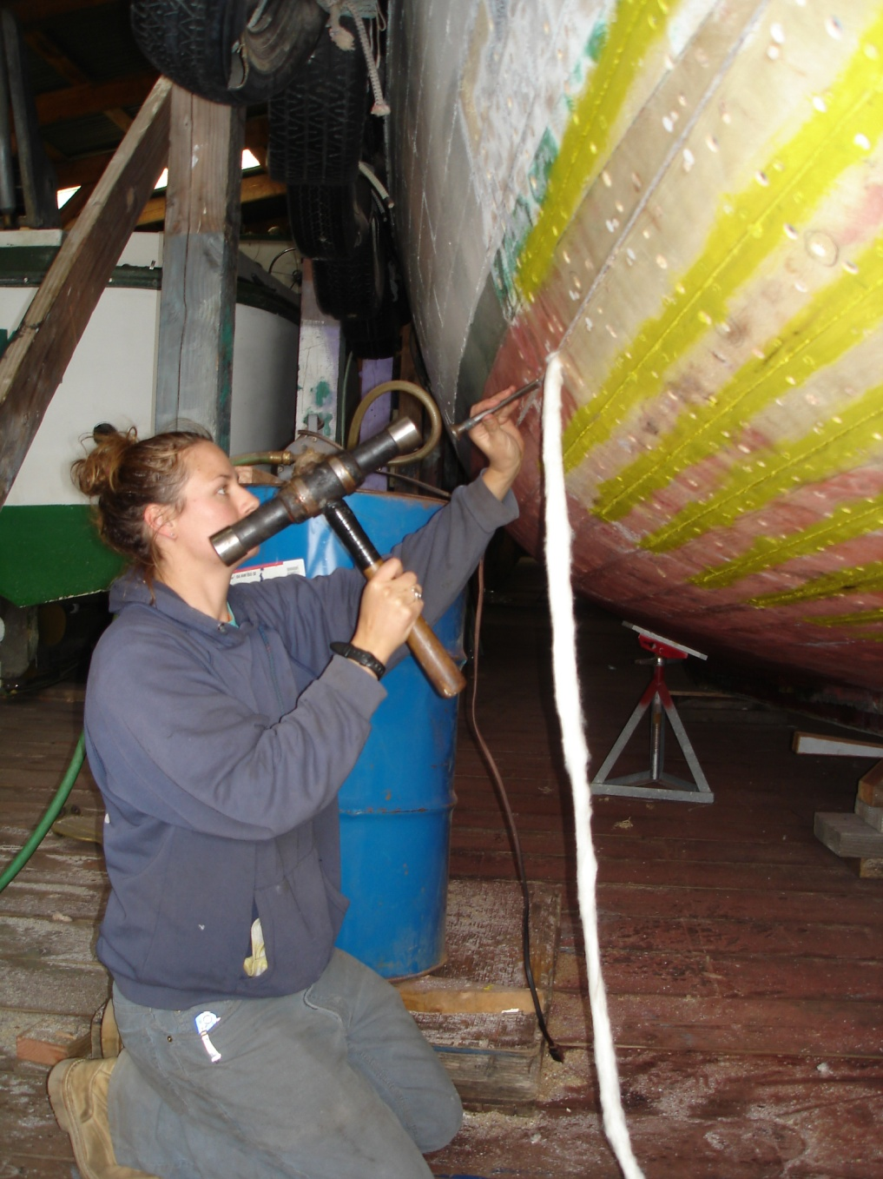
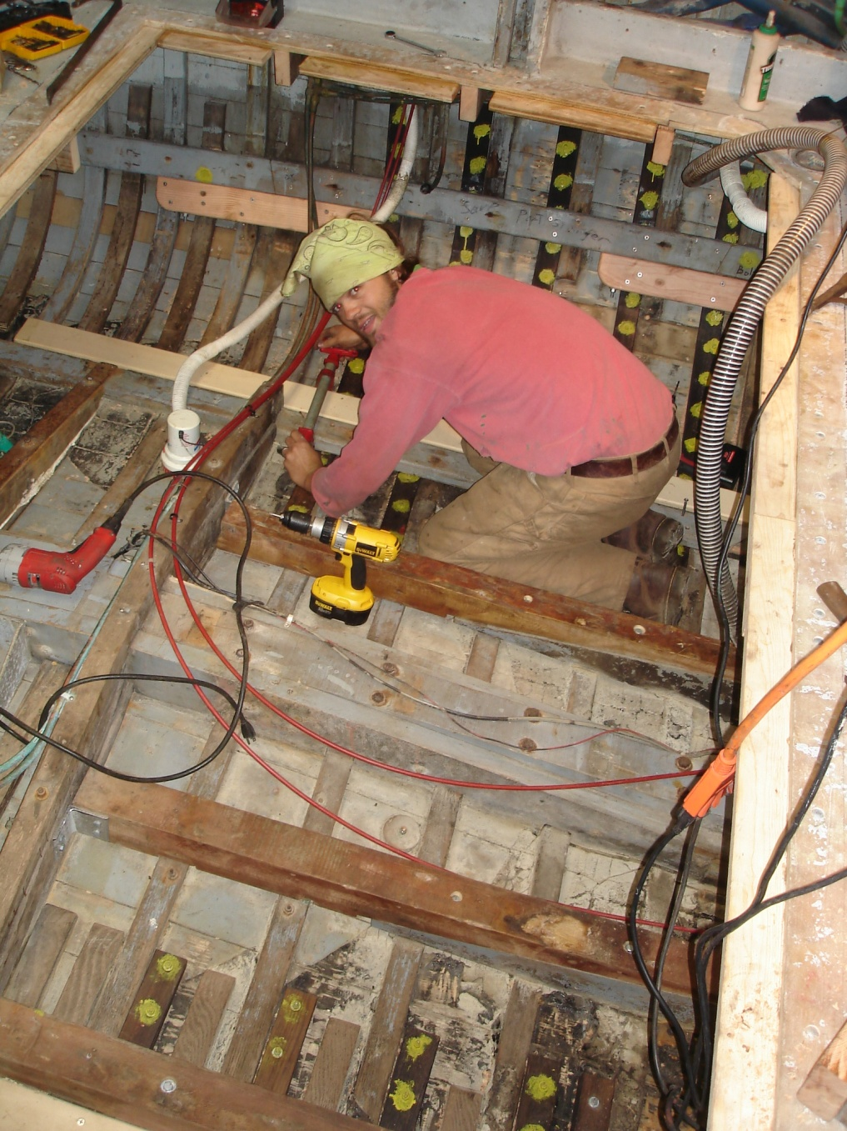

Slide 41
Example #2: at-sea accredited college field trips

Slide 42
teaching the next generation
Society, Environment & the Sea: Reading the Currents
college at-sea field experiences

Slide 43
passing on navigational skills

Slide 49
Example #3: prison inmate training & rehabilitation

Slide 50
reaching out to a new audience
prisoners learning maritime skills & restoring historic vessels

Slide 68
Example #4: traveling skill exhibitions for kids

Slide 81
Example #5: heritage tourism training for fisherman
http://www.watermenheritagetours.org/About-Us

Slide 89
transferring local generational knowledge

Slide 90
telling traditional maritime stories

Slide 91
Notes:
Greeting the visitor. Dockside heritage interpretation. Sailing trips. The Rebecca Ruark built in 1886 – a National Historic Landmark Vessel.

Slide 92
community storytelling
Notes:
Place matters! Story telling in an authentic heritage site. The RIGHT context.

Slide 93
Example #6:museum program: Apprentice for a Day

Slide 105
Example #7: after school boatbuilding for youth

Slide 115
Think About It!
“Knowledge comes from experience, everything else is [only] information”.
Albert Einstein

